Slide 1

Shark Offense
2013

Slide 2
Structure
Every player has a wristband which contains: formations, pods (style of play) and actual play
Formations are numbered 1-9. If we wanted to run to the opposite side, we would add a 0 to the end of the formation: Example trips right is the number 3 formation adding a 0 to it, making it 30, which would make it trips left.
Plays are echoed in from the sideline from players from Wr to qb to Wr

Slide 3
Structure Con’t
The pod is the style of play named with 4 similar names: We use NFL and NCAA teams. Example: Oakland and Raiders for outside runs or Indy and Colts for inside runs. We use four names so the defense will not be able to identify plays

Slide 4
Cadence and Count
Know the count
Hear the play and echo if needed
ready position – 2 point stance for linemen
QB yells, “Down!” or Ready
everyone snaps into their stance – no movement
QB yells a color and number twice, “Blue 14!”, “Blue 14!”
QB yells, “Go!” as many times as the count
fire out to your assignment

Slide 5
Calling plays/Audibles
Now we can actually use colors to help us identify defense or plans
Green/Blue= play is regular
Red= Check to the homerun pass
Brown=Check to Bubble/Jailbreak screen
Orange=Check to a Run
White= QB sneak
Silver=fake audible

Slide 6
Plays/Audibles(Continued)
We can use the wide outs’ numbers to identify who the pass goes to for example checking to Red 21 means the wide out who wears #21 is running the deep route, while everyone else runs hitches. Also all audibled plays are on 1.
Run Audible- Orange Then Hole number and Back so Orange 71 would be 1 back to the 7 hole or Orange 20 would be QB to the 2 hole
The numbers in the cadence will identify the number in the box and the number of safeties. For example 61indicates there are 6 in the box and 1 safety or 52 are five in the box with 2 safeties.

Slide 7
THE CENTER: THE MOST IMPORTANT ELEMENT
The feet parallel -- left foot should be slightly ahead of the right to facilitate a first choppy step to be used on blocking assignments.
Heels -- will be slightly off the ground. As you reached for the ball, weight will be transferred to the balls of the feet.
Legs -- spread legs as far apart as is comfortable. Then, the center reaches for the ball, approximately one half of the ball will be under his head. This will vary according to the length of the snapper's arms.
The Butt -- may be slightly higher than the shoulders and the back should be fairly straight. The tail should not be inordinately high. As the season progresses work to get the tail of your center lower, this will aid him in not having the high snap or bad pass.
The Head -- the head may be dropped enough to see the target between his legs.
Note: in high school, a center may never be hit around the head and should not be
hit in any spot until one second following the snap of the ball .
OUR SYSTEM
Q is Quarterback
F (2) is Tailback (Primary ball carrier)
H (3) is Hback (#2 ball carrier, WR #4, TE #2)
Y is TE (Good blocker on LOS, possession)
X is Split End (Best WR)
Z is our Flanker (Jet Sweep ball carrier, quick routes, lots of motion)

Slide 8
THE HUDDLE:
“A brief, efficient business meeting”
How we conduct and break the huddle sets the tone for how we will play once the ball is snapped…it must be disciplined, focused, and unified!
The Center sets the location of the huddle, then calls the business meeting to order by giving the down and distance situation.
Sprint to it and out of it! Create TEMPO!
Once the quarterback enters the huddle, he assumes COMPLETE control of the business meeting. NO ONE else talks!

Slide 9
THE HUDDLE
Our Sideline
Line of Scrimmage
LT
LG
C
RG
RT
X
Y
Z
H
A
Q
The huddle is 5 yards from the line of scrimmage. The Center is responsible for “calling” the huddle. Once called, the huddle is silent. The quarterback is the only one who will talk in the huddle. As the play is being called in or ran in by the Quarterback, it is important for the quarterback to communicate the down and distance to the other players. The offensive lineman should have hands on knees with eyes and ears forward. The quarterback will call the play 2 times. After the second time, the huddle will “break”! If you do not understand or hear the play, call “check” and the play will be repeated. A player should not go to the line of scrimmage if he does not know the play. After “break”, offensive line will “sprint” to LOS and get set.

Slide 10
HOW WE CALL PLAYS
First Word = Formation and backfield (with any special adjustments)
Second Word = Motion
Third Word = 2 Digits
First Digit tells the series of the play
Second Digit tells the hole the play is going and the play itself
Fourth Word = tells you the play as well as the blocking rules and the direction the play is being run
EXAMPLE
Pro Right Eye-- Zip -- 34 -- Zone Right
Formation
Motion
2 Back
run
series
The ball is
going to the 4
hole and is an
Zone
Tells you your blocking rules
As well as the direction of the play

Slide 11
HOLES
The second number in the two number running plays generally indicates the point of attack. We run all even numbers to the right and odd numbers to the left.
7
5
3
1
2
4
6
8
Holes 7 and 8 are wide running plays to the right and left respectively.

Slide 12
THE LINE OF SCRIMMAGE
FS
C
C
LB
LB
LB
LB
E
T
T
E
X
Y
H
Z
Q
A
1a. Offensive Linemen get in their stance and ready to get off the ball immediately!
1b. Quarterback gets to the line quickly, gets hands in ready position to force defense to adjust
2a. Center calls basic front structure (even, odd) and blocking scheme
2b. Receivers make coverage calls
3. Linemen make calls specific to the play being run
4. Quarterback begins cadence

Slide 13
QUARTERBACK ALIGNMENT
QB aligns 3 yards from the center
Feet are slightly staggered with throwing foot slightly in front (by 4 inches)
Hands are comfortable, with fingers spread
Center will snap ball into hands of the QB
On snap, the QB executes the running play or he checks his read on the passing play

Slide 14
RUNNING BACK ALIGNMENT
RB lines Up 3 to 4 yards behind QB. Or, if we are in gun, he is behind the offensive guard
His eyes are straight ahead
He is balanced, with his hands on his hips
If his hands go to his knees, he goes to the bench
We have some flexibility to his alignment with tags on our plays (Rock, Eye, King, Queen etc. explained later in the playbook.)

Slide 15
WIDE RECEIVER ALIGNMENT
All wide receivers will line up with the inside foot up.
Hands should be up in a sprinters stance or at their sides; weight should be over the toes.
Knees should be slightly bent.
Eyes should be looking in at the ball to know when it is snapped.

Slide 16
LINE SPLITS
Our line splits will vary depending upon the play call. However, we will remain consistently spread out on the OL.
T
G
C
G
T
Line splits are 1-1.5 yards.
That is 2.5-4 feet.

Slide 17
OUR SYSTEM
Q is Quarterback
F (2) is Tailback (Primary ball carrier)
H (3) is Hback (#2 ball carrier, WR #4, TE #2)
FB is Fullback (short yardage)
Y is TE (Good blocker on LOS, possession)
X is Split End (Best WR)
Z is our Flanker (Jet Sweep ball carrier, quick routes, lots of motion)

Slide 18
OUR RULES
Y and Z always go to the call side of the formation, unless there is a TE, then the Y goes to TE and the X and Z stay go to twins look.
When we are in 2 back sets, King tells H to go to away from the Y and Queen tells him to line up on the same side as the Y.
When we are in 1 back sets, Eye tells the A back to be behind the QB. Rock tells the A back to align to the QB’s side.

Slide 19
TERMINOLOGY I
Counter - A running play designed to get the defense going in one direction while the running back goes back against the intended pursuit of the defense. We generally fake to the H-Back and come back with a handoff to the F-Back. The guard on the backside pulls across and opens up the hole.
Zone - H-Back makes a lead block on the inside linebacker (isolation block 1 on 1) and the quarterback gives ball to the Tailback (F) through the hole. This is our base play. Zone blocking by the offensive line.

Slide 20
TERMINOLOGY II
Jet - A play when one of the wide receivers or slotback comes in motion as fast as he can towards the quarterback. On the snap, the QB meshes with the motion man and either gives him the ball or runs a counter play. This is our 50 series.
Option - A play when the quarterback has the choice of giving to the first man or running the ball himself with a second running back. This is our 40 series.
Power - Quarterback meshes with the F or H going across the formation. We will pull the backside guard and block down with the playside line.
Play-Action Pass - A passing play after the quarterback has faked a hand-off.

Slide 21
OFFENSIVE LINE TERMINOLOGY
You must know how your blocking scheme is set up as well as what position you play.
Backside refers to the part of the OL away from the play. Playside is the side the play is run.
PSG - Playside Guard
PST - Playside Tackle
C - Center
BSG - Backside Guard
BST - Backside Tackle
Backside
Playside
T
G
C
G
T
Q
B

Slide 22
KNOW YOUR ASSIGNMENTS
After the offensive line gets the number and play call (with direction), each player has got to know what blocking scheme we will use.
Because of this, we have 6 main blocking schemes that employ the types of blocks on the previous pages.
The 6 types of blocks are
Power/Counter -- Center and playside guard and tackle down block and the backside guard trap blocks the EMLOS backside tackle reach blocks.
Zone - Line drive blocks the man in front of them (DL or LB). Worked like a combo block. Double team DL on playside (G/T). Backside T or TE does not block the EMLOS. Get to second level/cut.
Trap -- Center and playside guard down block and the backside guard trap blocks the defensive tackle.
Option -- Line drive blocks the man in front of them (DL or LB) However…DO NOT BLOCK EMLOS to the playside (who will be DE or OLB, depending on the front.)
Jet -- Line reach blocks the man in front of them (DL or LB) to the playside (best cut block)
Stretch/Pitch -- Playside and Backside guard pull block around reach block of the playside tackle/Center

Slide 23
UNDERSTANDING DEFENSIVE FRONTS
It is imperative that our offensive linemen learn and understand the different fronts that they will be facing. You have to be able to ask yourself the following questions and understand the following points:
1. Is the front a 3, 4, or 5 man?
2. Is the man across from me head up, inside eye, or outside eye?
3. What linebackers in their defense like to blitz?
4. Can I see what I am blocking prior to the play(is my head up)?

Slide 24
DEFENSIVE FRONTS
We will identify the following fronts that we will see from our opponents.
3 Man Front
4 Man Front
5 Man Front
W
M
S
W
M
S
W
M
S
E
N
E
E
T
T
E
E
T
N
T
E
Typically known as a 3-5or a stack Defense
Typically known as a 4-3 or a 4-4 Defense
Typically known as a 5-3 or a 5-2 Defense

Slide 25
DEFENSIVE TECHNIQUES
We will identify the following defensive line techniques that we will see from our opponents.
Inside Eye
Head Up
Outside Eye
T
T
T
T
T
T
Both defensive tackles are shaded to
the inside of the offensive guards
Both defensive tackles are lined head
up on the offensive guards
Both defensive tackles are shaded to
the outside of the offensive guards

Slide 26

RUN BLOCKING

Slide 27
Basic Line play
Blocking Rules:
This is your progression of who to block. Fire out and step play side you first look to block the man which is:
“Head up” directly in front of you
“Gap away” man lined on your inside shoulder of the play
“Gap to” – man lined up on outside shoulder
Linebacker- Block the LB going toward the play
(Weak side players’ progression is Head up, Gap to, Gap away and then LB)

Slide 28
Line Play Con’t
Once the play is called lineman will be on the line of scrimmage.
Feet should be shoulder with apart with the line side foot’s toes lined to the other foot’s heel. (i.e. If you are on the right side the right foot is back)
Players then Ramrod (bow out their chest) and squat putting their hand down on the ground into the “set position” (Coaching point you should be balanced enough, that if your hand is kicked out, you will remain in the set position)
Lastly the players head should be up and looking forward at the

Slide 29
BLOCKING TERMINOLOGY
Base/Zone Block
Down Block
Reach or Hook Block
Fan Block
Pull Block
Kick Out Block
Trap Block
Chip/Combo Block

Slide 30
Run Blocking:
First step is out to play side. Lineman should fire up and out staying low with hands cocked and ready to fire into a man.
Aiming point is the numbers of the jersey for being head or squared up or outside number and shoulder if we are trying to seal a defender to the inside.
Once engaged we use short choppy and repeat short jabs with our hands to maintain a block. If you “lean on” a defender (engage him and don’t jab or chop your feet) the defender will drive you back into the play or shed you to make a tackle.
(Coaching point, try to stay under your opponent and drive him up and out)

Slide 31
TIGHT END BLOCKING
1. Hook -- On the snap take a short step straight upfield with your inside foot. If the DE is coming hard lock onto him and cave him down the LOS. If he is not coming hard, rub your outside arm and shoulder through the DE working from low to high. You should almost be scrambling upfield with your eyes on the LB. Step on the LB's toes and get to the upfield side and push him back to the LOS. If you miss the LB make him come underneath you not over the top. Do Dad 100% of the time on short yardage, goal line or keep.
2. Quick Veer Release (QVR) -- In most cases when you have a QVR you will be double teaming the LB with your OT. When executing this block, the TE MUST get outside leverage. As you make contact, maintain this outside leverage, keep the LB and get movement. The OT is your backside partner, it is his responsibility to step to you so the double team doesn’t get split.
3. Veer Release (VR) -- On the snap your first step is a lead step with your outside foot. Continue to pull outside to spot the man who has force. As you pull, it is crucial that you GET WIDTH - NOT DEPTH! Do NOT turn upfield until you are 1 yard outside the force man. Keep outside leverage on the defender and hook him by attacking his outside armpit. We want this block to occur about 2 or 3 yards from the LOS. Make contact by sticking your facemask into the defender’s outside armpit; attack the defender high and run over him by accelerating your feet. (Make sure you keep your feet) If you lose the defender, lose him underneath you - DO NOT allow him to go over the top of you.

Slide 32
WIDE RECEIVER BLOCKING
1. Stalk Block -- On the snap come off the line hard in a fly pattern. Do not get bumped inside. Take your man as deep as he will go. When he reads run, he will stop. STOP WHEN HE STOPS AND NOT BEFORE. When he plants in his backpedal, you should breakdown and backpedal 3 steps. Stay square to the defender and mirror him by shuffling from side to side. Wait for the DB to close on you, then attack him and stay high.
Keys:
Come off the line hard - sell the fly pattern
Stop when the defense stops - breakdown
Make the DB come to you
2. Route Block -- On the snap of the ball you will run a PRE-DETERMINED route if the defense is in man to man coverage. The defender covering you will be essentially blocked because she will be running with you away from the ball carrier.

Slide 33
ZONE BLOCKING

Slide 34
WHAT IS ZONE BLOCKING?
Zone blocking is simply a style of blocking that allows for those blocking to block an area and not be specifically tied to a particular defender.
Two or three players work in unison to block an area for the ball carrier, rather than working alone.

Slide 35
RULES
Our offensive line rules begin with the playside gap
Our landmark is the playside jersey number of the defensive lineman
Our offensive line takes a six inch zone step to the play side at a 45 degree angle, depending on the technique of the defensive lineman
On our first step, our offensive lineman will grab their guns (This term tells our lineman to get their hands cocked)
The second step is through the crotch of the defender
The offensive lineman is trying to punch through the playside jersey number
We keep our feet moving to get our head across the midpoint of the defender
We must keep our feet moving to get to the playside

Slide 36
GAP RESPONSILITY
TE
T
G
C
G
T
TE
Play Direction

Slide 37
FIRST TWO STEPS
The initial movement of the lineman begins with two steps. If a lineman is covered, there is a jab step and a gather step
If a lineman is uncovered, there is a scoop step and a gather step.
Note -- Players must know if they are going to come off the combo block or stay on it.

Slide 38
COVERED LINEMEN
1st step is a six inch playside jab step, drawing elbows back
2nd step brings the trailing foot up field in between defenders feet, explode arms forward at the defenders #’s
Shoulders square to LOS

Slide 39
UNCOVERED LINEMEN
1st step is a playside scoop step, drawing elbows back
2nd step brings the trailing foot up field in a sweeping manner, explode arms forward
Shoulders square to LOS

Slide 40
STEPPING PLAYSIDE…
PUNCHING THE NUMBERS
Step at 45 degrees with
The outside foot at the
DL’s outside #.
98
Most likely he is outside
Gap responsible, so we
Want a hat on his outside #.
Play Direction

Slide 41
STEPPING PLAYSIDE…
STRAIGHT UP TECHNIQUE BY DL
Step is straight ahead with the
Outside foot at the outside #.
98
The DL has a 2-way go, but the
OL is outside gap responsible.
If he comes outside the OL will
Still have outside leverage.
If he goes inside, it is not the OL’s
Gap responsibility. He will punch
& go to level 2.
Play Direction

Slide 42
THE SCOOP STEP
Used for the 34/35 zone and some midline plays
Each lineman zone scoop steps playside
Blocking an area, not necessarily a set defender

Slide 43
ZONE BLOCKING: THE COMBO
Basis for all zone blocking
Covered man posts up
Uncovered scoop steps towards DL

Slide 44
STAY ON YOUR BLOCK…
LET THE DEFENDERS COME TO YOU
Used with Combo block
Use double team to LB
Let the defenders decide who you will block

Slide 45
EXAMPLE
FS
CB
LB
CB
LB
LB
RB Read 2
RB Read 1
DE
DT
NG
DT
DE
X
C
T
G
G
T
Y
Z
H
QB
PRO RIGHT KING 34 ZONE
A

Slide 46
ZONE BLOCKING PRINCIPLES
Switch call used -
Guard takes DE and Tackle takes DT

Slide 47
DEALING WITH STUNTS
F
C
R
W
M
S
C
E
T
T
E
When the defensive line stunts, our lineman must understand their first responsibility is playside gap
They must have their heads up and eyes open

Slide 48
HANDLING STUNTS
B
B
B
L
E
T
T
E
This is a two-on-two drill working two offensive lineman vs. a defensive lineman and a backer. This is a generic drill where we will put guards with tackles and centers with guards. We want this to be a game speed drill once the initial teaching is done.
You must work against twists and loops
This is our three on three drill we do a lot because of stacked fronts. We get head up tackles that will slant. We work this drill with the frontside, then the backside. We get our eyes up and this teaches the kids to be able to work an inside threat. We teach patience in this drill and we follow a very strict rule, “Don’t Chase Backers.”

Slide 49
PASS BLOCKING

Slide 50
Pass blocking:
Player always fire out and never backwards or stand up. Once a player has fired out keep a good blocking base (knees bent in front of your belly and hand cocked and ready fire into a pass rusher. Your head should be on a swivel looking for someone to hit. Punish them for trying to hit your QB.

Slide 51
PASS BLOCKING SCHEMES
Any discussion of the passing game has to start with how you are going to block your opponent.
All of our pass protection schemes are rule oriented. The lineman need to learn their rules and not what man they are blocking, this becomes very important when defenses begin to stem and stunt. For our diagrams on pass protection, we will diagram all plays with a TE (Y) as well as without. The pass pro is easily changed with or without a TE.
We use few as protections as possible to make the OL learning curve very easy. Linemen that do not have to think are more aggressive.
Below are the 4 different pass protection schemes:
--1 Step Drop -- Cutblock Protection Scheme
--3 Step Drop -- Big on Big Protection Scheme
--Sprint Out -- Hip-Hinge/Reach Protection Scheme
--Play Action -- Waggle Protection Scheme

Slide 52
THE QUICK GAME - 1 STEP
When we call a one step passing play, the offensive line will be alerted that we will use “cutblock” protection. The QB should receive the snap and deliver the ball right away to the open receiver. He should know where he is going to throw the ball BEFORE the snap.
Here are the rules for the protection:
--Tackles: Aim for the thigh pads of the DL. If you are not covered, then stay low to give the QB a good throwing lane.
--Guards: Aim for the thigh pads of the DL. If you are not covered, then stay low to give the QB a good throwing lane.
--Center: If covered, aim for the thigh pads of the DL. If not, keep your head on a swivel for the MLB blitzing. With only one running back, look to the right side of the ball, because the RB will align on the left.
--RB: Take three VERY quick steps to the Line Of Scrimmage (LOS), looking at inside rusher. Look for MLB to come shooting and block first color that shows. Step to rush; do not wait for him to get to the QB.

Slide 53
CUT BLOCK DIAGRAM
S
M
W
E T T E
Come off the line hard into the DL knees. The defender’s hands must be down.
Center check the blitzing linebacker then continue drop
Cutblock Protection
Running Backs will also step up into the A gaps

Slide 54
THE QUICK GAME - 3 STEP
The the quick throw portion of the offense is known as “Big on Big” protection. We use this protection with our quick game in order to open up throwing lanes for the QB and invite that rush end up field and keep him from swatting the ball down.
Here are the rules for the protection:
--Tackles: Kick slide protection. You are blocking the End Man on the Line Of Scrimmage (EMLOS). In a 4 man front, this is the DE. In a 3 or a 5 man front, it will be the OLB. Block whoever is OUTSIDE of your alignment.
--Guards: Kick slide protection. You are blocking the defensive tackle.
--Center: After securing the snap the QB, step up to immediately punch the nose guard vs. an odd front or a blitzing LB vs. an even front. With only one running back, look to the right side of the ball, because the RB will align on the left.
--RB: Take three VERY quick steps to the LOS, looking at inside rusher. Look for MLB to come shooting and block first color that shows. Step to rush; do not wait for him to get to the QB.

Slide 55
BIG ON BIG DIAGRAM
S
M
W
E T T E
QB must make Hot Read off of outside pressure.
Center Must check for Backer while giving A gap support
Cup Protection
Running Backs will also step up into the A gaps

Slide 56
PLAY ACTION WAGGLE PASS
Our play action pass series is known as the waggle. We will pull the backside lineman (guard) and fill with the RB after his mesh with the QB. QB will stay inside the pocket and NOT roll outside of the block by the pulling guard.
Here are the rules for the protection:
--Backside Tackle: Turn and Hip-Hinge (protect the playside gap until the RB can fill for the pulling lineman. Then, get depth and kick slide to your drop.
--Backside Guard: Belly pull down the LOS until you get 1 yard outside of the tackle box. Block the first man who shows. Try to push the EMLOS outside and let the QB set up inside your block. RB fills for your pull.
--Center: Protect backside then get to the playside on a reach.
--Play side Guard: Block straight up. Do not give up any ground.
--Play side Tackle: Block straight up. Do not give up any ground.
--RB: Take the mesh fake from the QB. Get up to the LOS to fill for the pulling lineman.

Slide 57
WAGGLE PASS DIAGRAM
S M
W
E T T E
QB must stay inside the pocket and inside the block of the pulling guard

Slide 58
PASSING GAME AND THE BLITZ
In all the routes that we use, we will designate a blitz control receiver. When the defense goes Cover 0 or no safety in the middle of the field, then we will check to hitch route against loose corners and 4 verticals against press corners.. The screen is also a great weapon against the blitz. Since we run the gun then we have to develop the mentality of “Recognize, React, and Destroy” when it comes to the blitz. We must force teams into stop blitzing or make them pay dearly on the scoreboard if they continue.
Recognize, React, and Destroy

Slide 59
BASE RUNNING GAME

Slide 60
QB HANDOFFS = IMPORTANT
QB will take the football through the 3rd hand, open at 45 to the call side, and reach the ball deep.
The QB is responsible for the handoff reaching the navel of the running back.
The handoff must be 2 inches below the sternum.
We tell the QB to step at 45 and roll it back.
The QB will either boot fake after giving the football or he will attack the playside DE.

Slide 61
RB FOOTWORK
The Tailback will take a false step to the playside and ensure the QB secures the snap.
The tailback will rollover his outside foot and make a deep soft pocket with his top palm out.
The tailback’s eyes are reading the flow of the first frontside combo block on the DT or NG.
TB must read the gaps from A to B, but with patience.
The tailback must burst to first daylight.

Slide 62
RUNNING DOWNHILL
W
M
E
T
T
E
We can have the QB fake frontside or backside.
Q
F
Tailback takes a hard downhill step with his playside foot.
Then works downhill to the Void
TB must be prepared to win a 1 on 1 battle with the LB (if the H back is not in the game and we are in EYE.

Slide 63
RUNNING GAME RULES
Keep -- If we “tag” a play with Keep, the QB will execute the running play, but keep the ball.
Give -- If we “tag” a play with Give, the QB will give the ball to the first back and then run the fake with the second back. (Normally given to H and fake with F).
Pull -- If we “tag” a play with Pull, the QB will execute the running play, but keep the ball. (Normally faked to H and given to F or option).
When we are in 2 back sets, King tells H to go to away from the Y and Queen tells him to line up on the same side.
When we are in 1 back sets, I tells the F back to be behind the QB. Rock tells the F back to align to the QB’s side.

Slide 64
THE QB/RB MESH

Slide 65
WAYS WE MESH
A mesh is when the RB comes downhill on the snap and receives or fakes a handoff with the QB. This can also happen on the jet sweep.
Same Side Mesh (Veer Give)
Backside Give (Zone)
Designed QB Pull Play (Zone Keep)
Option (Mesh with RB then option)
Play Action Mesh
Jet Sweep (Mesh with Motion Man)

Slide 66
QB FOOTWORK FOR THE MESH
If The Running Back is crossing the QB, the QB will take a flat step toward the back. We call this Flat Step, Short Step.
He reaches the ball deep and feels the belly of the back, snapping his eyes to the LOS and his “read,” (the DE).
He rides the Running Back through while making his read.
“Squeeze and Chase” or “Pull and Replace”

Slide 67
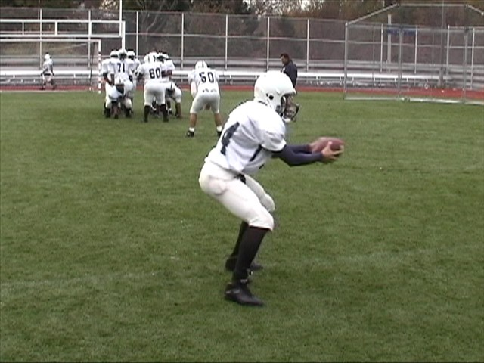
QB FOOTWORK ON THE MESH

Slide 68
RB FOOTWORK FOR THE MESH
The Running Back aligns 1.5 to 2 yards behind the QB, straddling the inside leg of the tackle in the rock formation.
If the Running Back is crossing the QB, on the snap, he will immediately come downhill with the QB.
He must make a deep pocket, with the top palm up.
The Running back must feel the QB handoff, and not snatch at the football from him.
If he takes the ball or not, he must have TWO hands on the ball.

Slide 69
SQUEEZE AND CHASE
PULL AND REPLACE
If the DE squeezes and chases, the QB will pull and replace
The QB will give the ball to the RB if…
If the DE slow plays, give the football
If the DE comes upfield, give the ball
If the DE comes at the QB, give the ball
We get one more blocker to the second level

Slide 70
Diagram Of The Mesh
READING THE DE ON THE MESH
E
Read Key
The QB Takes A Flat Step To The Back, then a short step. His feet should face the Sideline, in a heel toe relationship at the mesh point. His weight should be slightly right

Slide 71
Diagram Of The Mesh
READING THE DE ON THE MESH
E
Read Key
If the DE comes upfield, give the football to the back and carry out your run fake.

Slide 72
Diagram Of The Mesh
READING THE DE ON THE MESH
E
Read Key
If the DE squeezes and chases, the QB will pull and replace.
The QB must get downhill

Slide 73
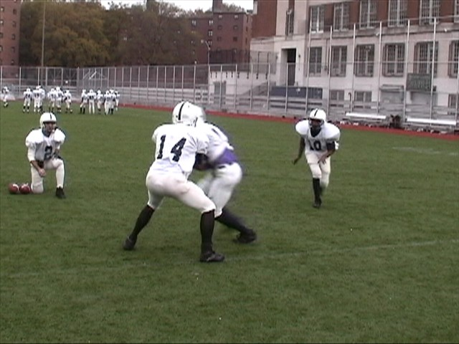
READING THE DE ON THE MESH
QB gets his eyes to his read
Always simulate a snap
The QB is giving the football as the DE is coming up field.
This is a great view of the quarterback’s footwork on the mesh. You can see the angle of his feet allowing the back to cross in front.

Slide 74
KEYS TO A GOOD MESH
The QB must secure the snap first!
The QB MUST get his eyes to his read
The RB must make a deep soft pocket
The RB must be patient, don’t rush
The QB must be soft with the football

Slide 75
PASSING GAME AND THE BLITZ
In all the routes that we use, we will designate a blitz control receiver. When the defense goes Cover 0 or no safety in the middle of the field, then we will check to hitch route against loose corners and 4 verticals against press corners.. The screen is also a great weapon against the blitz. Since we run the gun then we have to develop the mentality of “Recognize, React, and Destroy” when it comes to the blitz. We must force teams into stop blitzing or make them pay dearly on the scoreboard if they continue.
Recognize, React, and Destroy

Slide 76
PASSING GAME BASICS

Slide 77
PASSING GAME PHILOSOPHY
We have five basic tenants in our passing game philosophy…
We must protect the quarterback (Pass Pro)
We want to control the pace of the game with the pass (run to pass)
We will incorporate an effective play action game and screen game to complement our power running game (Be multi-faceted)
We will take what the defense gives us (pre-snap read by the QB)
Coaches must constantly KISS the offense (Keep It Simple Silly!)
By doing these things we can still be a ball control offense and take advantage of what the defense is giving us. Big plays come from misalignments or mismatches that we are able to create with formations, personnel groups, and motions. Big plays also occur with the receiver's ability to run with the ball after the catch.

Slide 78
Quick Game
Quick
Hitch
Slant
2 0
2 0
2 0
3 0
3 0
3 0
2 steps
5 steps
2 steps
Come off the ball with 2 hard steps. Sell vertical route to DB. On second step, take 1 step inside and look for the ball. QB is throwing based on pre-snap read of DB cushion.
Vertical release at defender working to his outside. Plant outside foot on 5th step. Do not work back to ball. QB will deliver ball to the shoulder away from defender.
Quick release vertically 2 steps, plant outside foot and make cut to open grass. Anticipate ball at the break. Get up field immediately to avoid inside defenders. Anticipate contact.

Slide 79
Quick Game
Fade
Hugo (Hitch & G0)
Hitch Whip
2 0
2 0
2 0
3 0
3 0
3 0
4 steps
5 steps
5 steps
Vertical push towards inside shoulder of defender. On forth step shift gears as you break outside. Maintain 4-5 yards from sidelines, look over inside shoulder and follow ball in with your eyes.
Execute the HITCH route, flash hands to QB as if to catch the ball. Pivot to the outside to avoid contact and get vertical and leave 4-5 yards from sideline for QB to drop ball in over outside shoulder.
Take best release and run 5 step hitch route and work back outside and sit in the open grass. Vs. man keep working to the sidelines.
Outside Receivers will sit in open windows and not work outside.

Slide 80
Quick Game
Flag
Post
Go
2 0
Vs. 2 safety
2 0
2 0
Vs. 1 safety
Vs. 1 safety
3 0
3 0
3 0
5 steps
TE/Slot Route. Best release 5 steps, give little head fake inside like you’re about to sit on a stick route. Run to open grass. Split the difference between the safety and cornerback.
Vertical release to a depth of 10 yards. Make cornerback think corner route by leaning to outside shoulder before you plant and break inside to post. Run to open grass between FS and Cornerback.
Best release and push vertical staying on the hash vs. a 1 safety look. Vs a 2 safety look split the safeties.

Slide 81
Deep Game
Comeback
Out
Dig
2 0
2 0
2 0
3 0
3 0
3 0
12 yards
5 Yards
10 Yards
Work best release and make it look like a fade pushing to a depth of 12 yards. Plant inside foot and turn outside by pulling back on inside elbow. Work inside to find a window or open grass.
Vertical push towards inside shoulder of defender. On forth step shift gears and sell the fade. At 5 yards plant inside foot and work out.
Inside release, push vertical 10 yards and break inside. Find the open window or grass and settle vs zone or continue to run across the field vs. man.

Slide 82
Deep Game
Wheel
Get Open
Slugo
2 0
2 0
2 0
3 0
3 0
3 0
6 yards
3 steps
Quick outside release and sell the arrow route. Once you get to 5-6 yards from the sidelines, turn downfield pressing vertically and maintain 4-5 yards from sidelines so QB can drop ball in over outside shoulder.
Inside release and sit under the linebacker drops. Find open grass and square up to QB. You must try and stay over the ball between the guards.
Sell the slant, plant outside foot and pivot back flat to the outside accelerating to the sidelines.

Slide 83
Deep Game
Hunt
Drag
Post/Corner
2 0
2 0
2 0
3 0
3 0
3 0
5 yards
10 yards
Inside release and avoid linebackers. Work to 6-8 yards and gradually gain depth working into the opposite hook to curl area.
Inside release for 3-4 yards gaining depth and work across the field under the linebacker drops no deeper than 5 yards.
Vertical release to a depth of 10 yards. Plant outside foot make a post move for 1-2 steps and then break to the deep outside finding open grass. Locate ball and adjust.

Slide 84
WHAT MAKES OUR PASSING
GAME SUCCESSFUL?
In order to move the ball with the pass, both the quarterback and the receivers have to be on the same page and understand the adjustments and changes that must be made in the course of a game.
For instance, the QB must be able to read a two deep safety vs. a man free scheme. Or the receiver must be aware of the difference between man and zone coverage.
Via the scouting report and game plan, these things will be evident and allow us to capitalize on the defenses weak spots during the game.
The following pages have the different defensive fronts and coverages that we will see.
Our coaches will assume that offensive skill players understand these schemes.

Slide 85
FRONT IDENTIFICATION
B B
B
E T T E
E T T E
4-2 (5 DB’s)
4-1 (6 DB’s)
M
B B
B B
E T N T E
E T E
5-1 (5 DB’s)
3-4 (4 DB’s)
B M B
B M B
E T T E
E T E
4-3 (4 DB’s)
3-3 (5 DB’s)
B B
B B
E T E
E T E B
3-2 (6 DB’s)
3-3 Eagle (5 DB’s)

Slide 86
RECOGNIZING COVERAGE
SCHEMES AND RUNNING ROUTES
Types of Coverage
Cover 0 – 0 Deep with Man Under. Usually BLITZING other 6 defenders
Cover 1 – 1 Deep with Man Under. Drop, bring, or spy with extra defender
Cover 2 – 2 Deep with Man or Zone Under. Weak zone if bring more than 4
Cover 3 – 3 Deep with Zone Under. Weak zone if bring more than 4
Cover 4 – 4 Deep with Zone Under. Weak zone if bring more than 3

Slide 87
Cover 0
B B
C
S
F
C
E T T E
S
Cover 1
F
B B
C
S
S
C
E T T E

Slide 88
Cover 2
F F
B
C
S
S
C
E T T E

Slide 89
Cover 3
C
F
C
B B
S
S
E T T E

Slide 90
Cover 4
F F
C
C
B
S
S
E T T E

Slide 91
THE PASSING READ ROUTE
The outside receivers run the appropriate route depending on the coverage of the DB. The QB will throw the ball in the following progression.
DB off more than 5 yards– Quick
DB in outside squat– Slant
DB in inside squat– Flat
DB in press– Fade

Slide 92
C
A Slant is run when the DB is in a head up press look or an outside squat position on the WR. This is a 2 step slant.
The quick is run to a WR in which the DB is more than 5 yards off the WR.
C
O
O
An out is run when the DB is sitting off taking away the slant.
The Fade is thrown when the DB is in a press position taking away the slant. The WR runs straight up the field for 5 yards and then angles to the sideline, always looking for the ball. The ball is thrown 6 yards down the field.
C
C
O
O

Slide 93
Motions
Motion position calling “1hawkRaider20”
X= Xena
H=Hawk
Y=Yankee
Z=Zulu
F=Falcon

Slide 94
Wristband
Formations |  |  |  | Pods
1 | ACE | Oakland/Raiders |  | Tennessee Titans |  | Carolina/Panthers
2 | BLUE | 1 | OUTSIDE ZONE | 1 | HITCHES | 1 | JET/REVERSE
3 | GREEN | 2 | SWEEP/TOSS | 2 | X'S | 2 | SHARK PASS
4 | BUNCH | 3 | JET H | 3 | Y CORNER | 3 | QB SNEAK
5 | I SET | 4 | SPEED OPTION | 4 | Y STICK | 4 | POGO
6 | QUADS | 5 | QB SWEEP | 5 | FOX | 5 | Z PASS
7 | EMPTY | Detroit/Lions |  | Philly/Eagles |  | Indianapolis/Colts
8 | KING | 1 | Y SAIL | 1 | JAILBREAK | 1 | INSIDE ZONE
9 | QUEEN | 2 | MESH | 2 | BUBBLE | 2 | LEAD
 |  | 3 | VERTICALS | 3 | F SCREEN | 3 | ISO
 |  | 4 | SMASH | 4 | DRAW | 4 | DIVE
 |  | 5 | Y Curl | 5 | SLANT/BUBBLE | 5 | COUNTER
 |  | 6 | MESH POW |  |  | 6 | TRAP
 |  | Seattle/Seahawks |  | Dallas/Cowboys |  | 7 | FAKE DIVE ZONE
 |  | 1 | X | 1 | ZONE PASS | Pitt/Steelers
 |  | 2 | Y | 2 | WAGGLE | 1 | OUT | 6 | DIG
 |  | 3 | Z | 3 | JET PASS | 2 | SLANT | 7 | POST
 |  | 4 | H | 4 | LEAD PASS | 3 | IN | 8 | CORNER
 |  | 5 | F | 5 | BOOT PASS | 4 | HITCH | 9 | FLY
 |  |  |  |  |  | 5 | COMEBACK | 0 | SLIDE

Slide 95
Formations
1 ACE
2 BLUE
3 GREEN
4 BUNCH
5 I SET
6 QUADS
7 EMPTY
8 KING
9 QUEEN

Slide 96
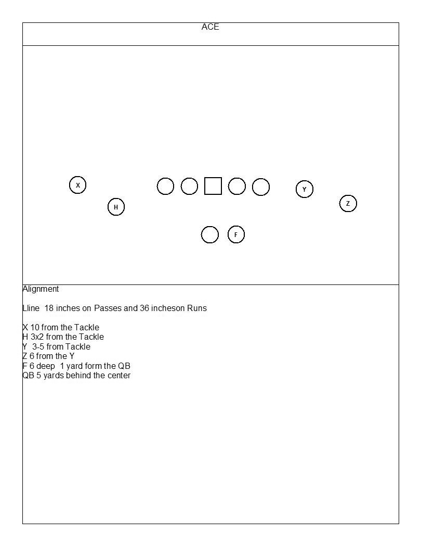

Slide 97
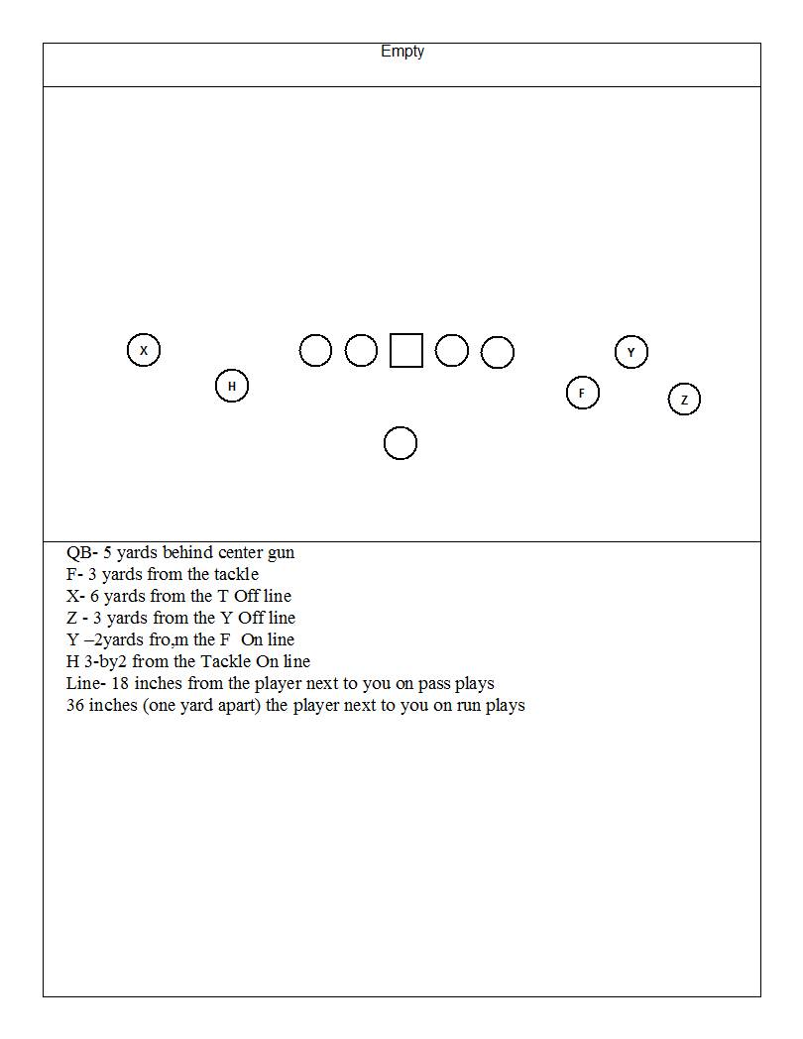

Slide 98
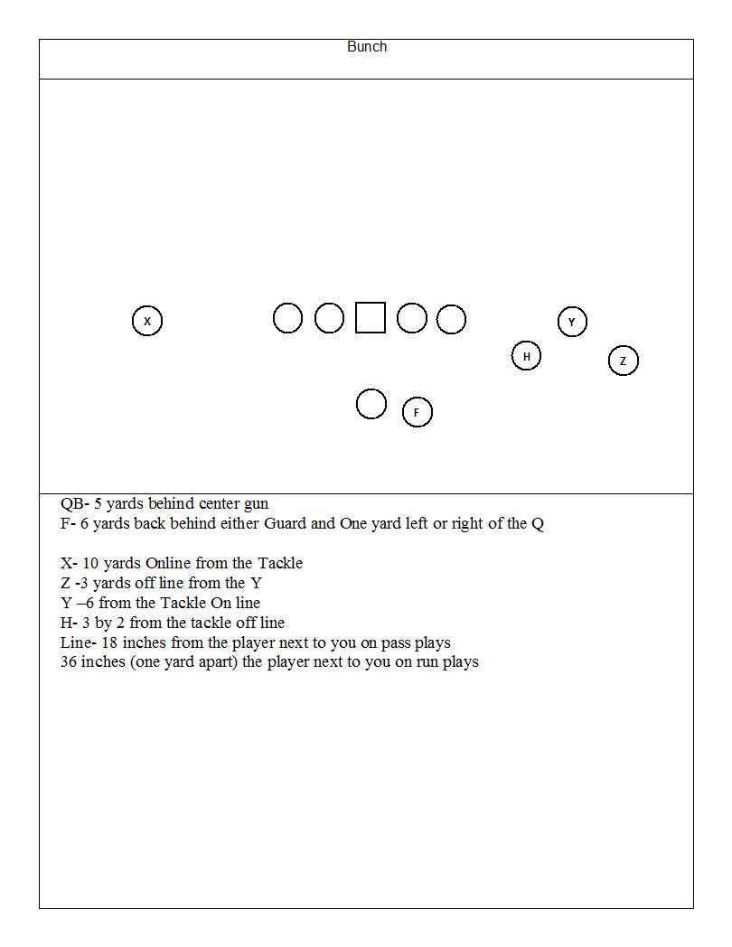

Slide 99
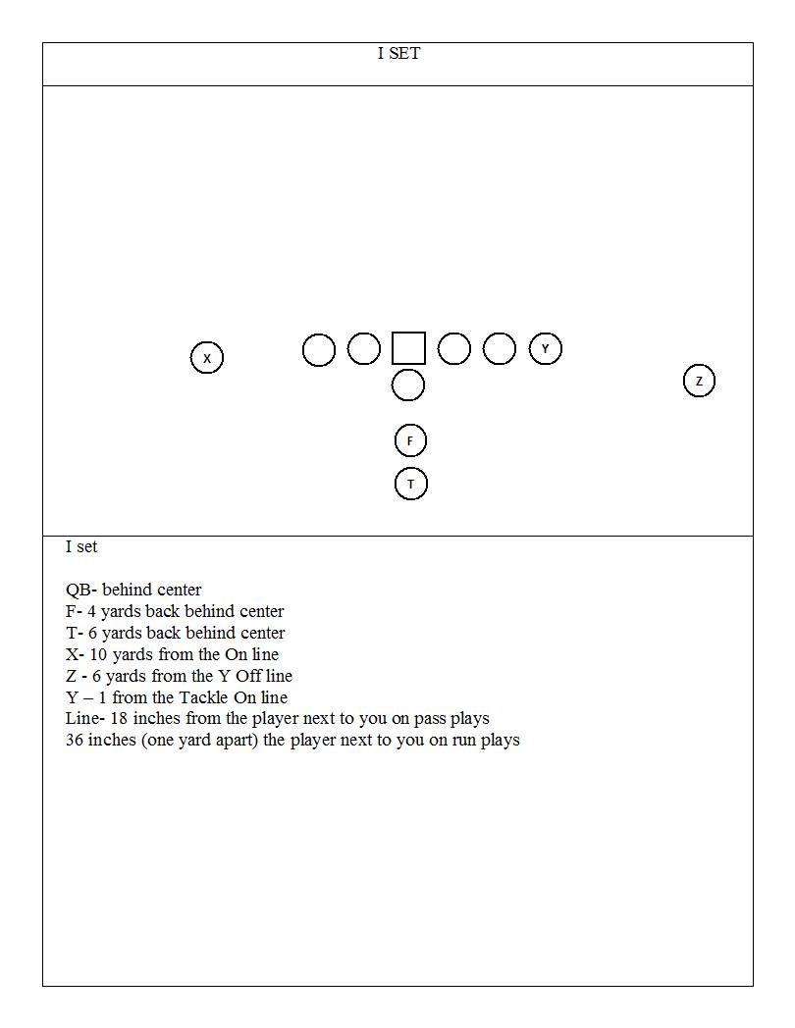

Slide 100
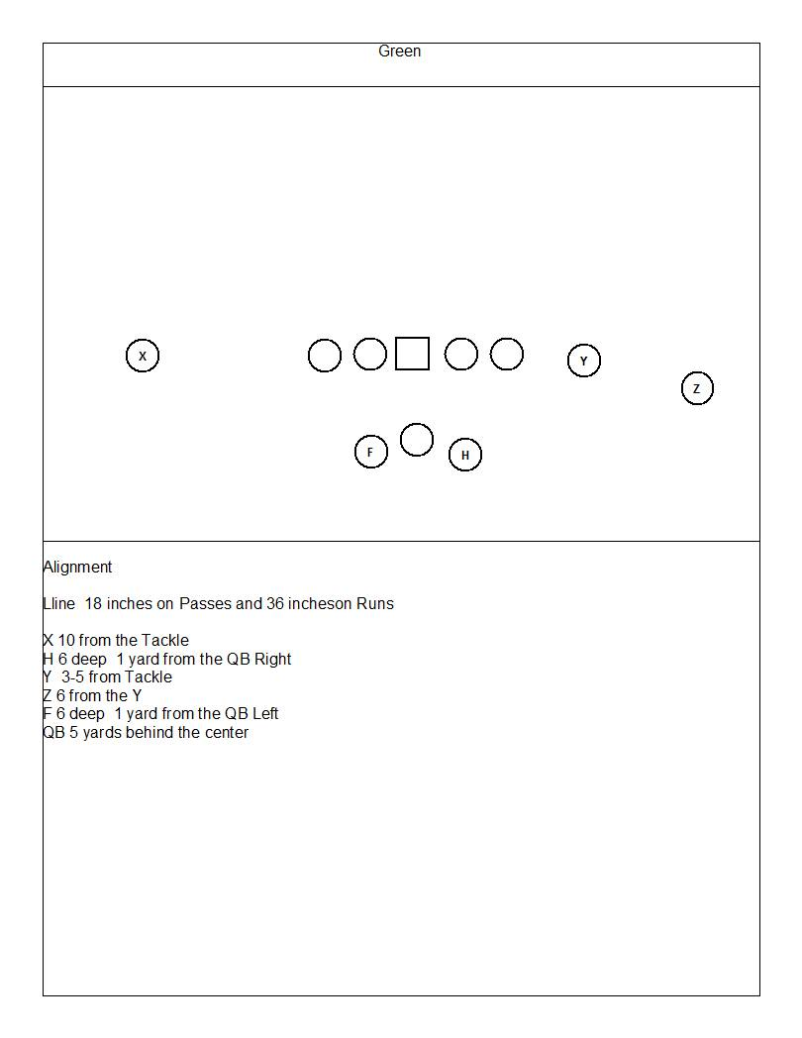

Slide 101
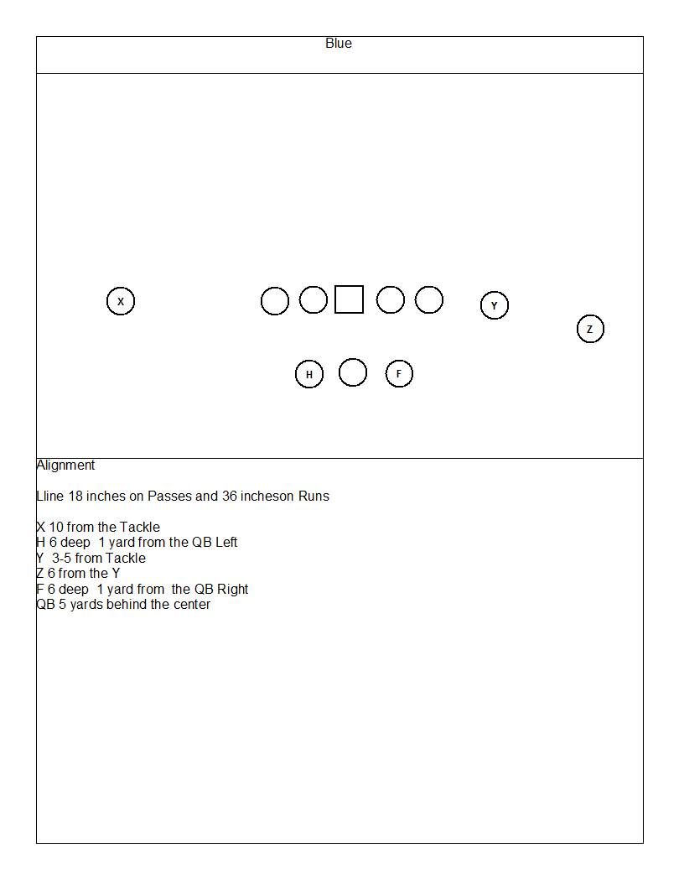

Slide 102
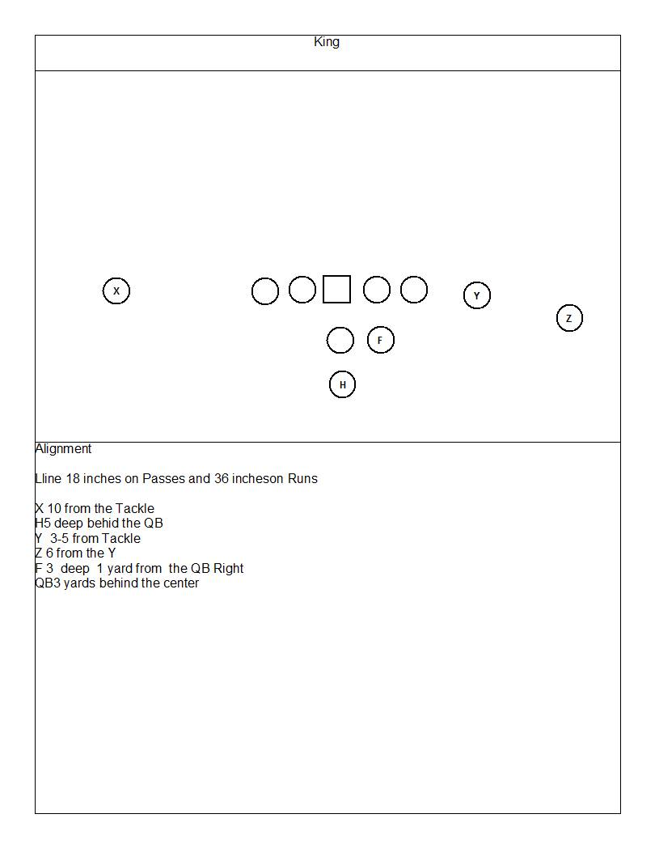

Slide 103
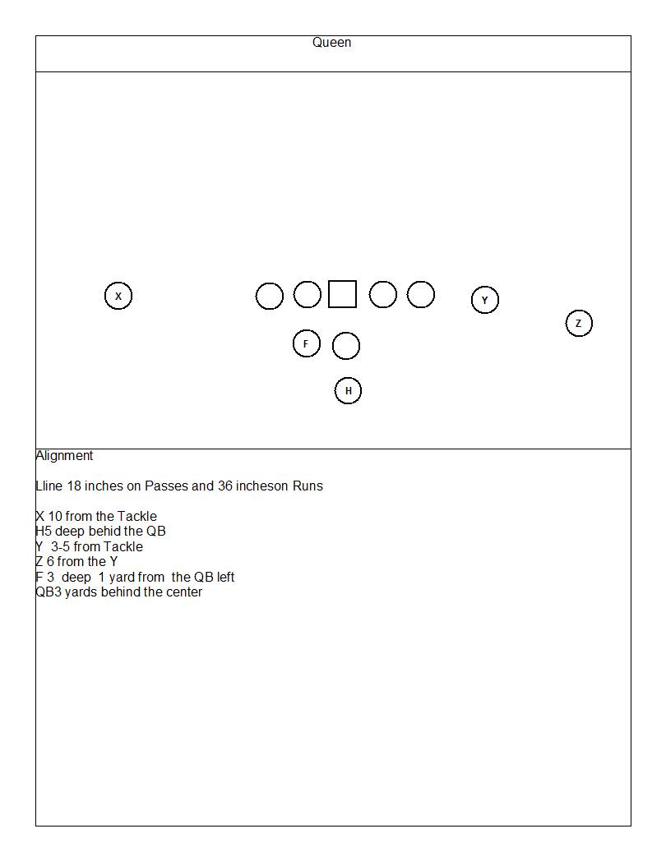

Slide 104
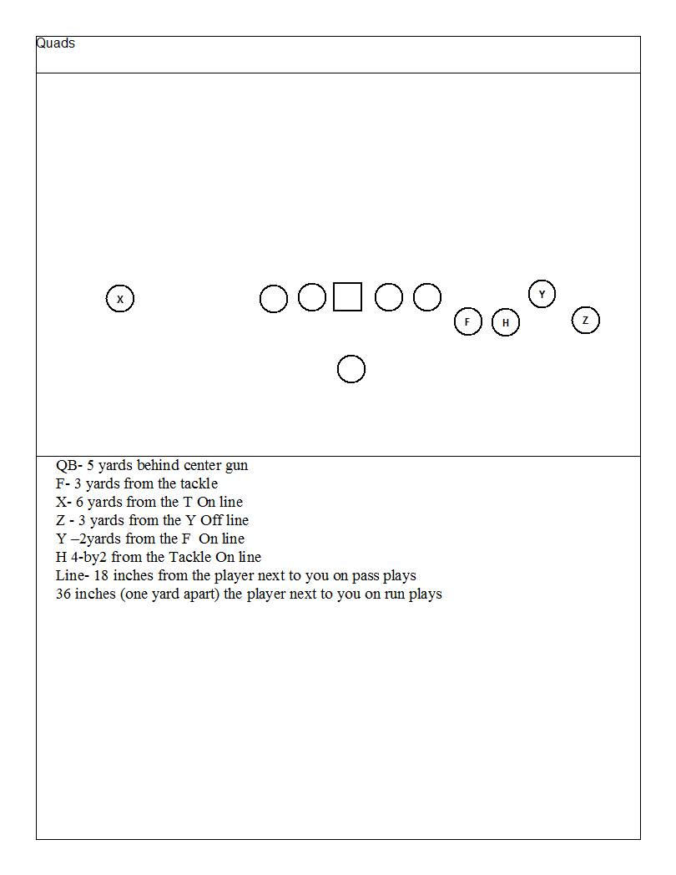

Slide 105
Pods set up
Outside Runs= Oakland Raiders
Inside Runs= Indi Colts
Shallows= Seattle Seahawks
3 step passes= Tennessee Titans
5 step passes= Detroit Lions
Special Plays (tricks and reverses)= Carolina Panthers
Play action passes= Dallas Cowboys
Screens and Draws= Philly Eagles

Slide 106
Outside Runs
Outside zone Run
Sweep
Jet sweep

Slide 107
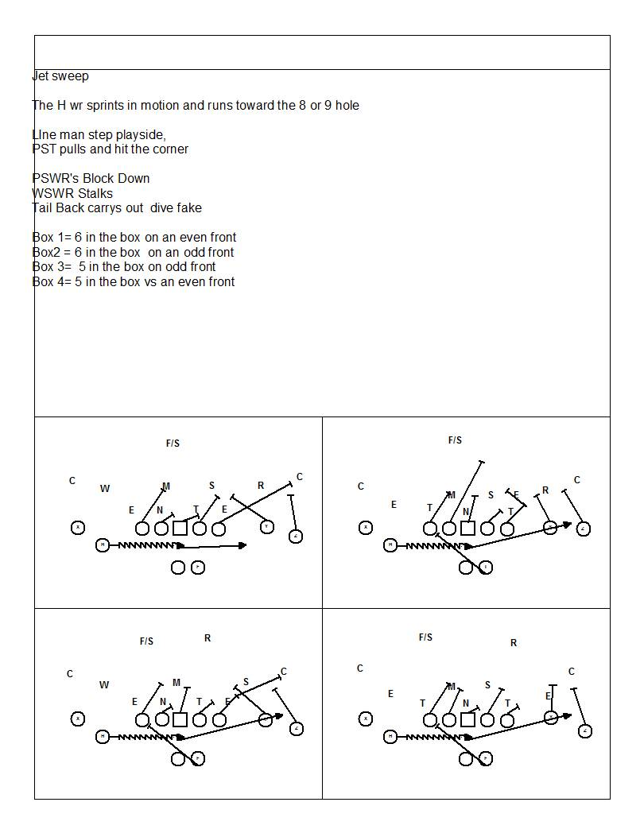

Slide 108
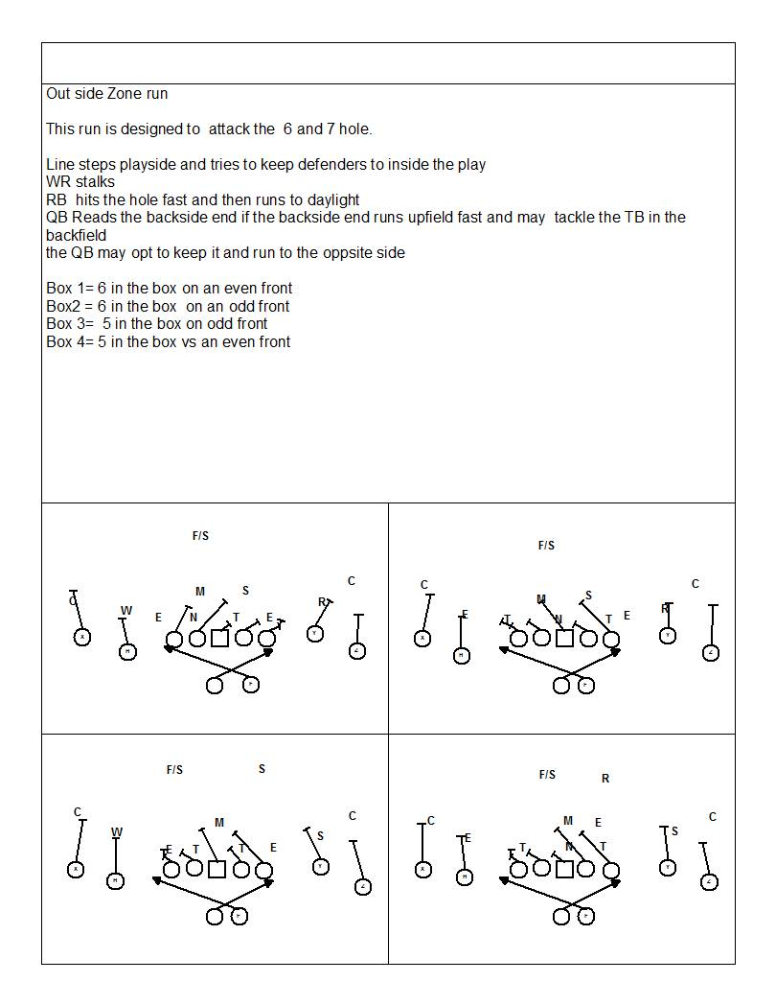

Slide 109
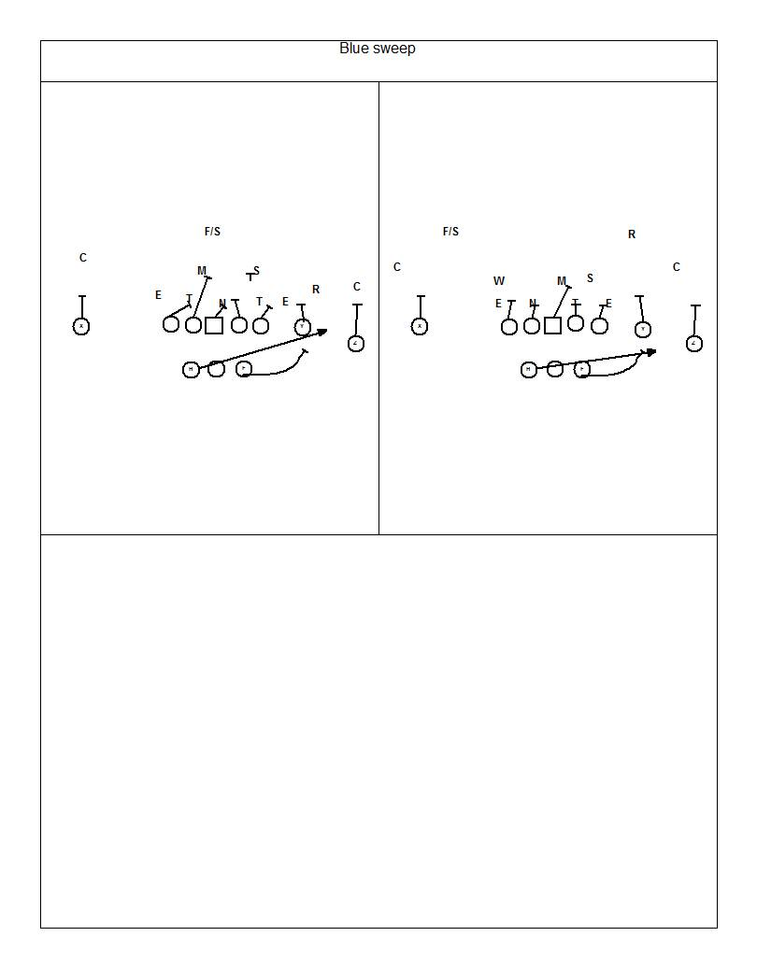

Slide 110
Inside runs
Inside zone
Lead
Iso
Dive
Counter
Trap

Slide 111
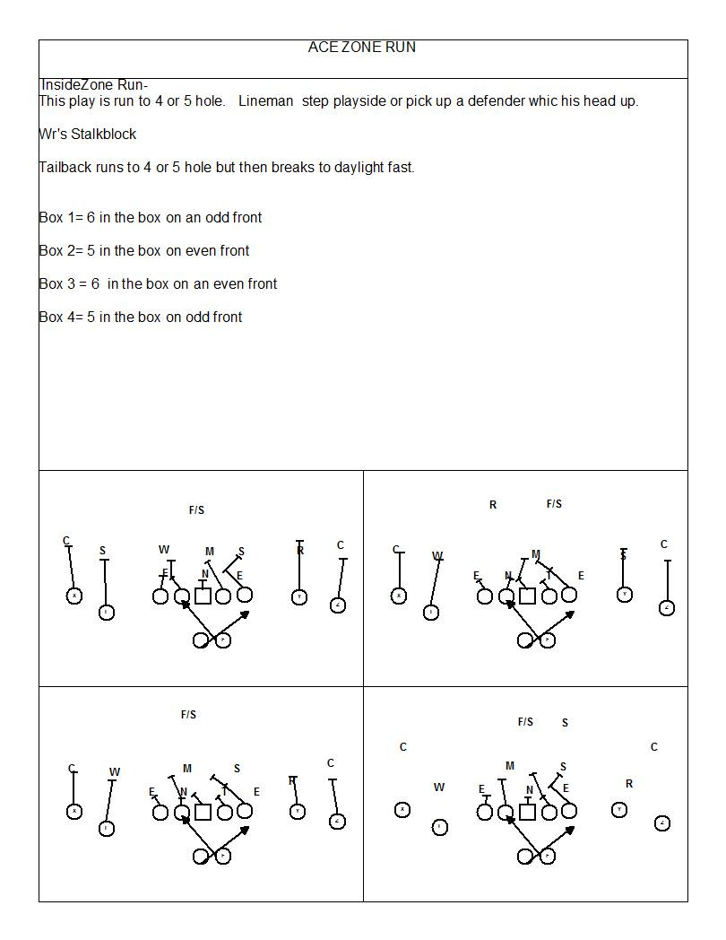

Slide 112
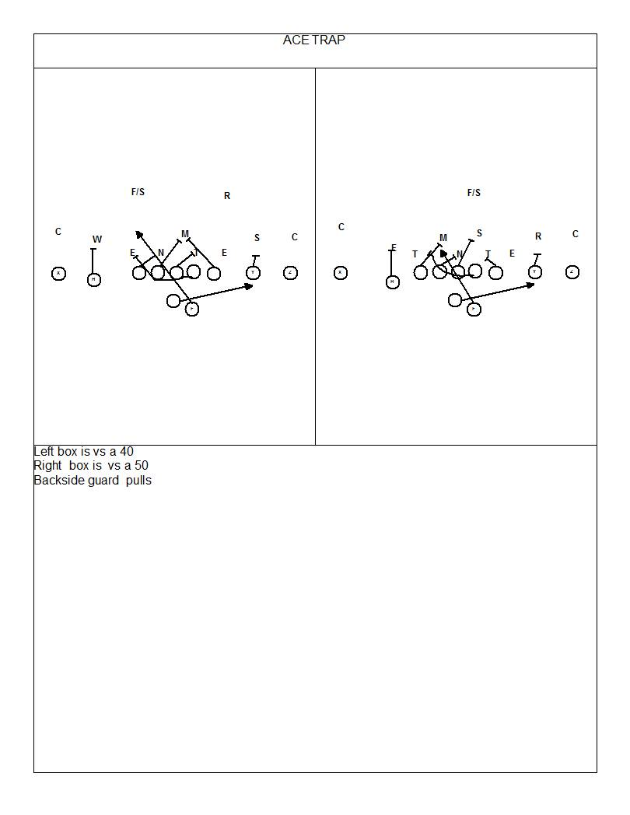

Slide 113
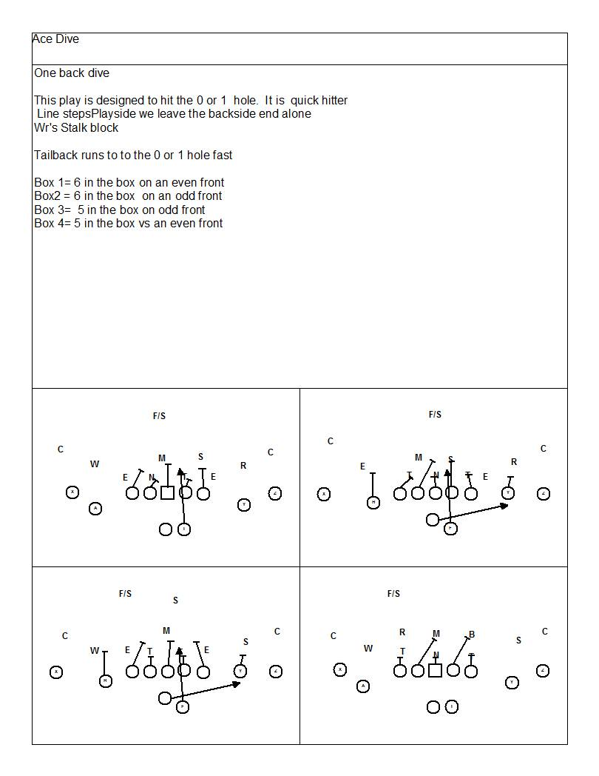

Slide 114
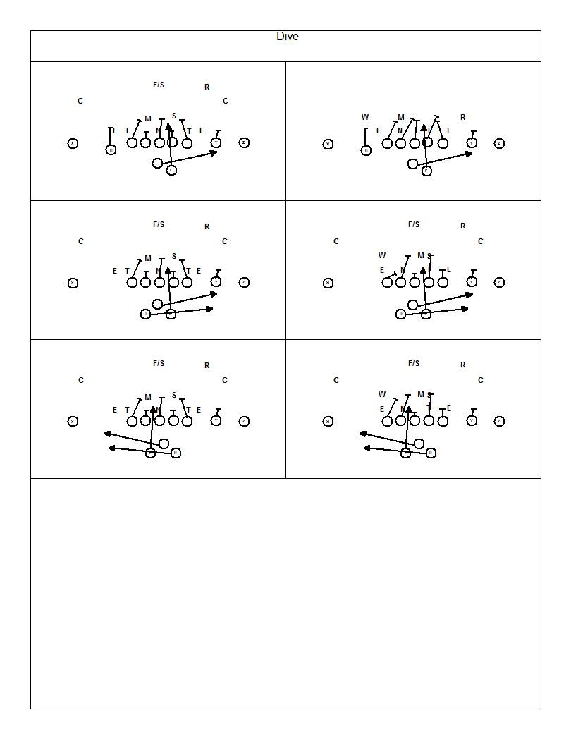

Slide 115
Screens and Draws
Jail Break
Bubble Screen
F screen
QB Draw
Slant/Bubble

Slide 116
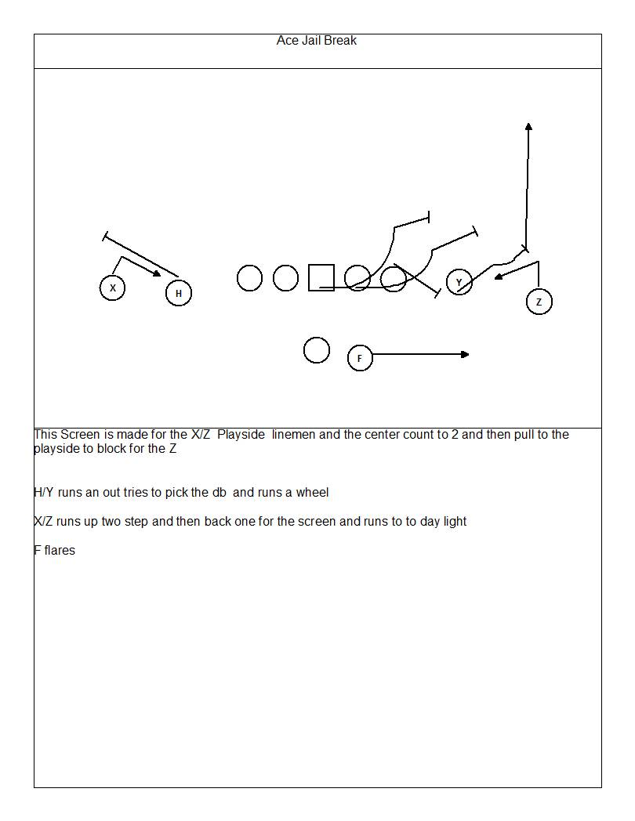

Slide 117
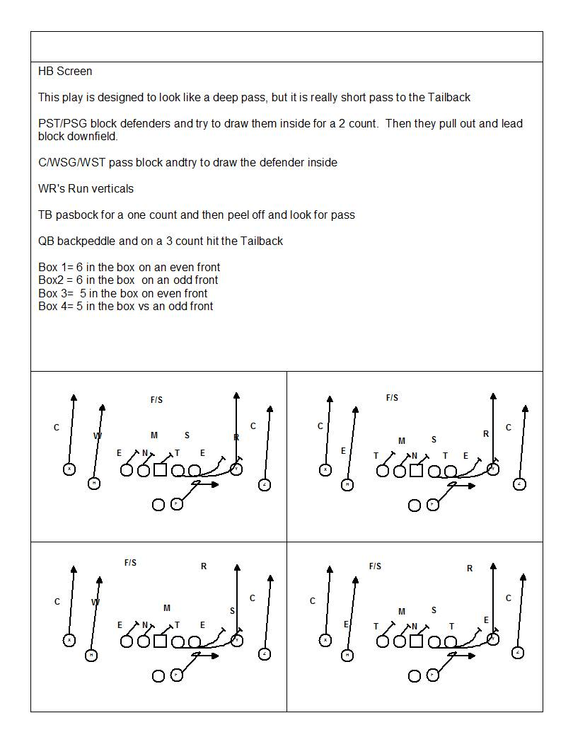

Slide 118
Slip SCREEN
Run to Daylight
X
Y
#
H
Z
Open Hips to Sideline
Attack the Outside Hip of the FG
Catch the ball 1-2 yards behind the LOS
F
Hide in the OL (Sell the Block)
C -- Pass Set for 1, Release Outside and Hit First Opposite Color
PSG -- Pass Set for 1, Release Outside and Hit First Opposite Color
PST -- Invite Outside Rush, Set for 2, Then Cut
BSG -- Pass Set for 1, Release Outside and Hit First Opposite Color
BST -- Pass Set and Lock On, Can Release Down Field Late
X – Crack the 1st linebacker inside of you
WR’s - Block man over, Against man run him off

Slide 119
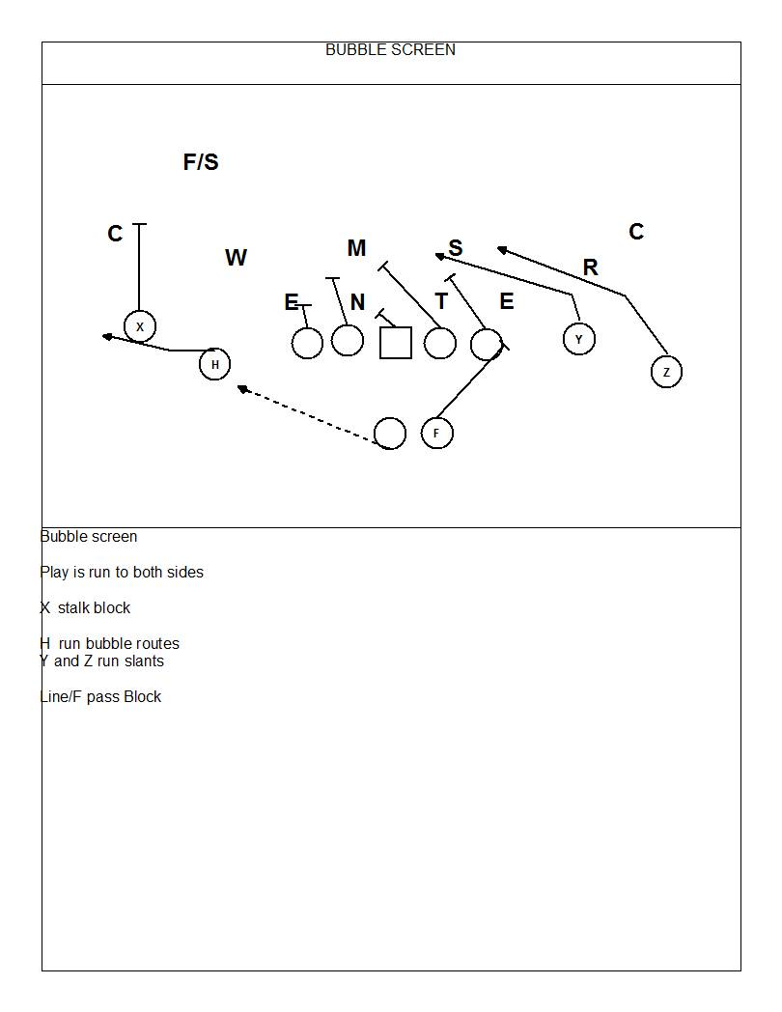

Slide 120
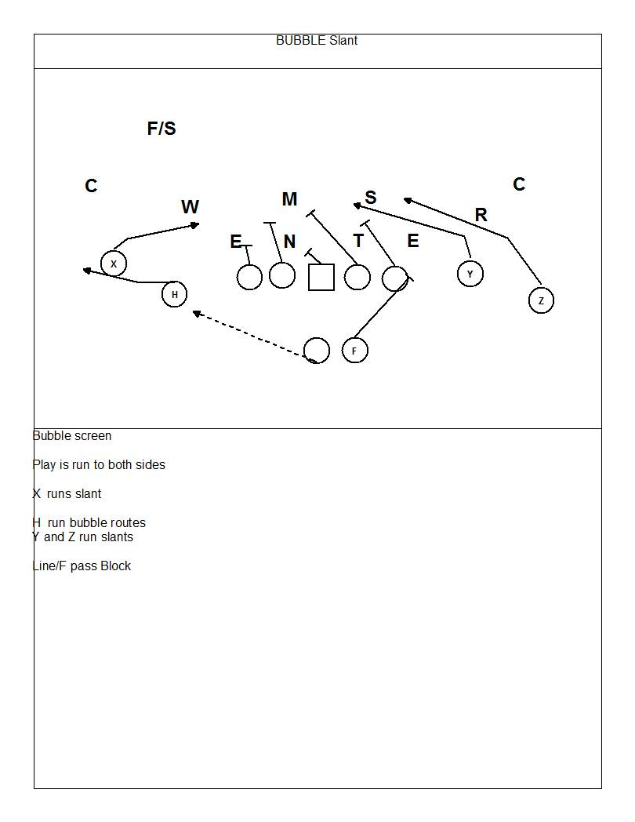

Slide 121
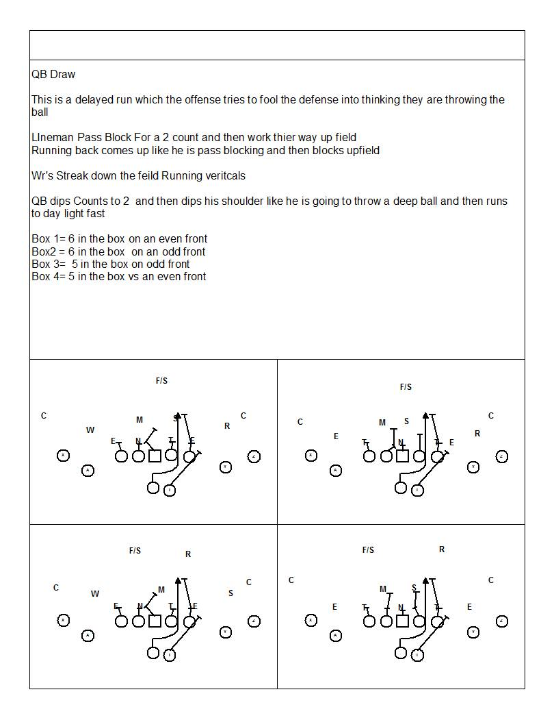

Slide 122
Shallows
X
Y
Z
H
F

Slide 123
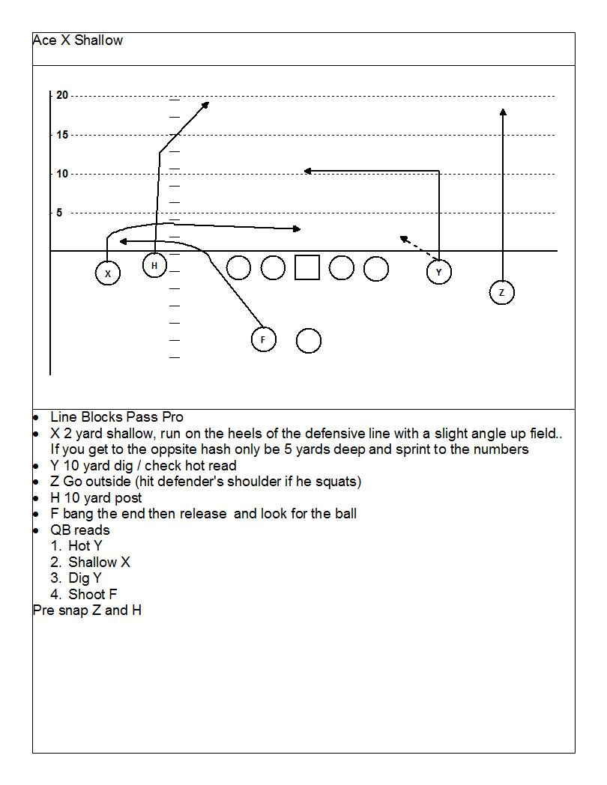

Slide 124
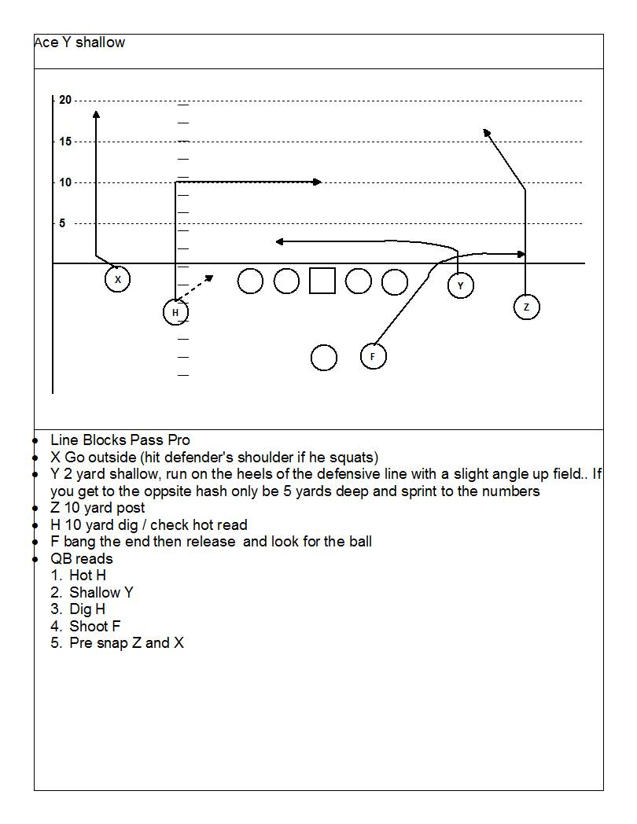

Slide 125
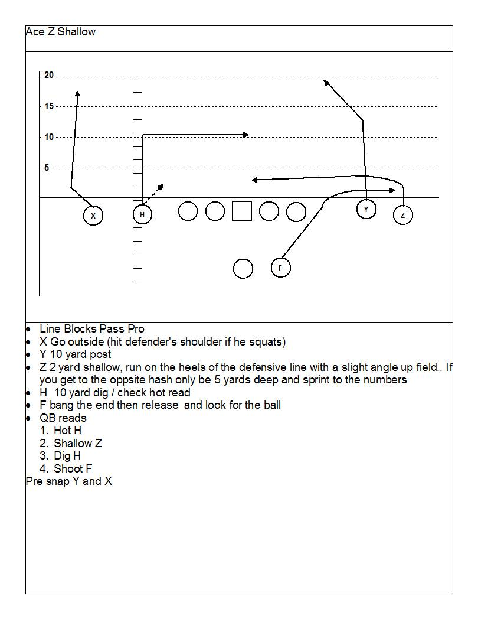

Slide 126
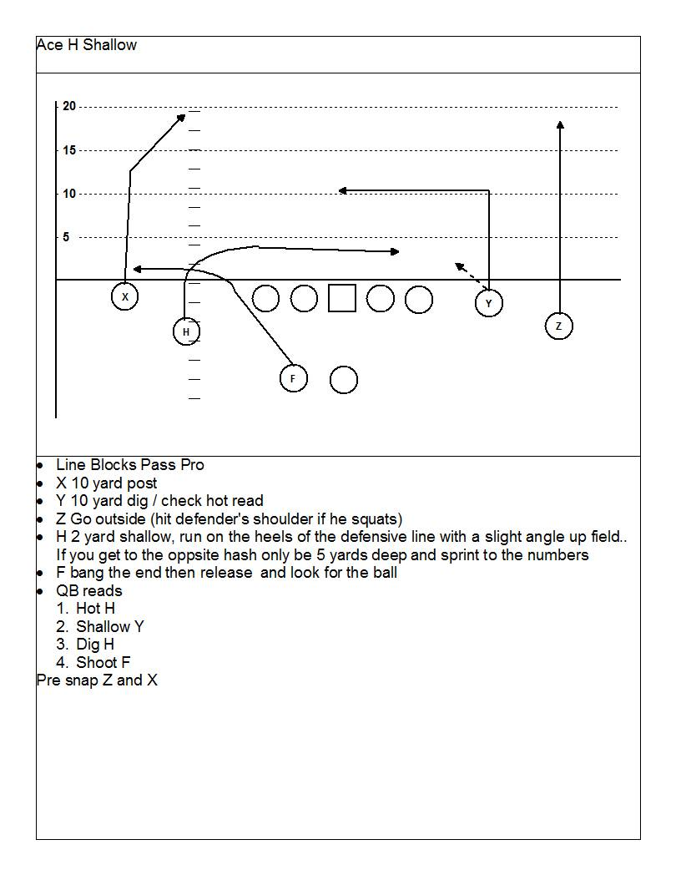

Slide 127
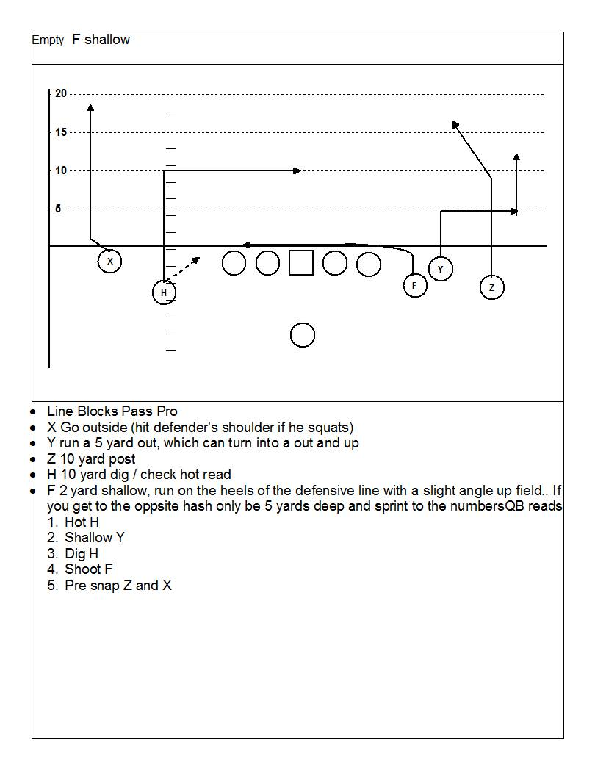

Slide 128
3 step passes
Hitches
Spread X’s
Y corner
Y stick
Fox

Slide 129
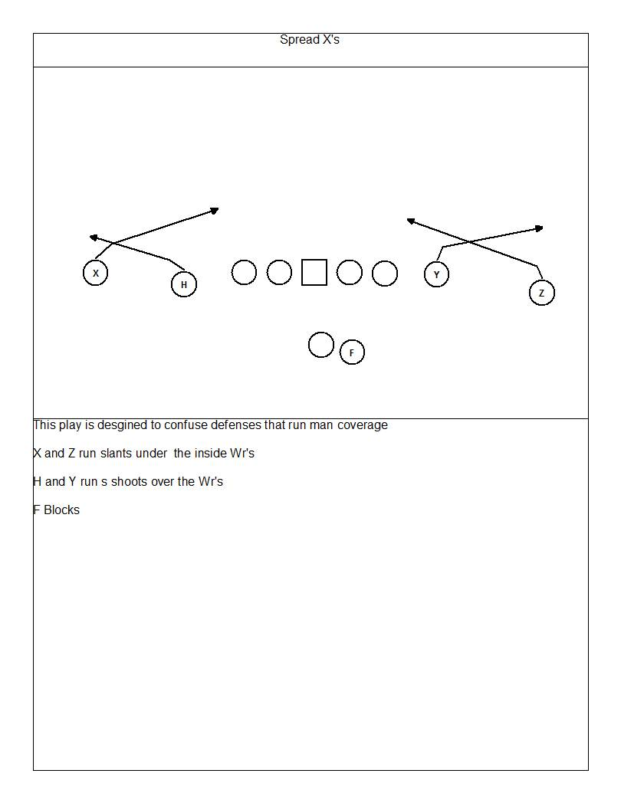

Slide 130
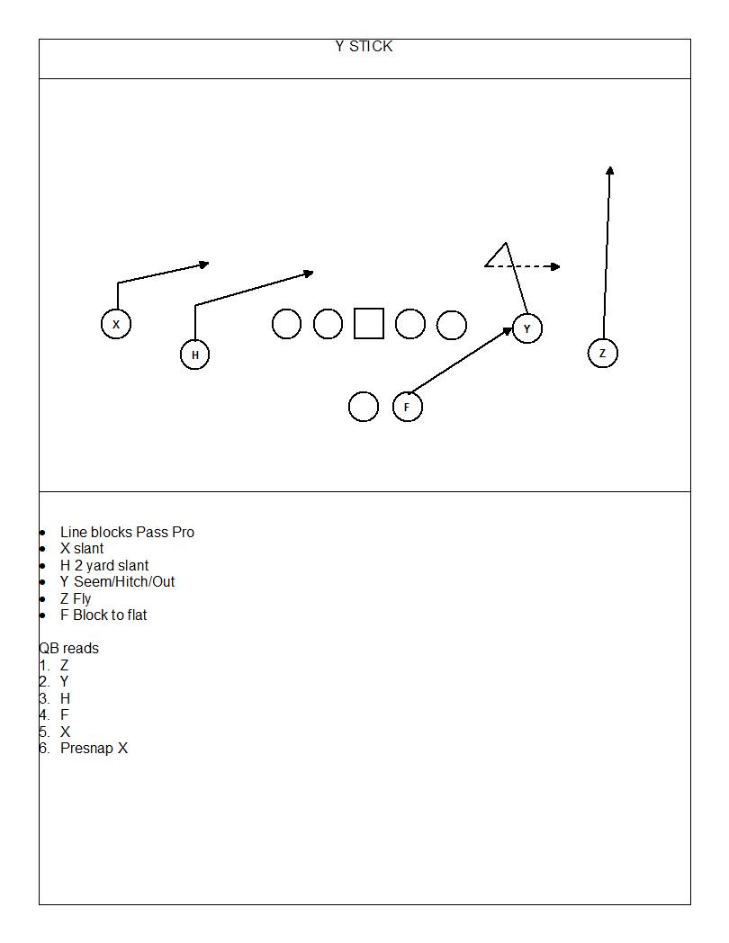

Slide 131
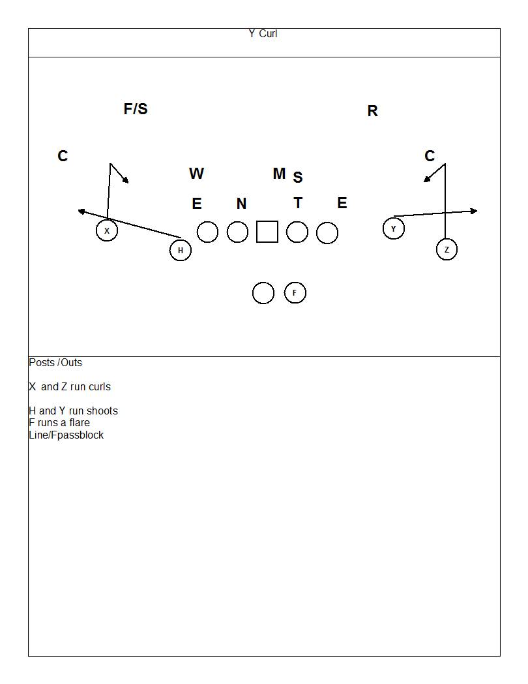

Slide 132
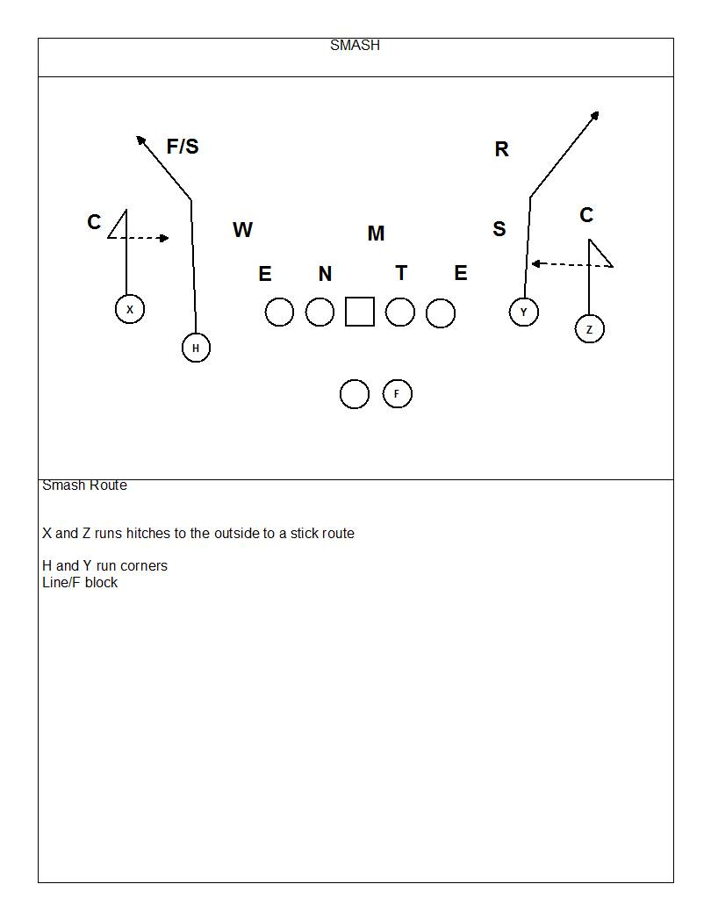

Slide 133
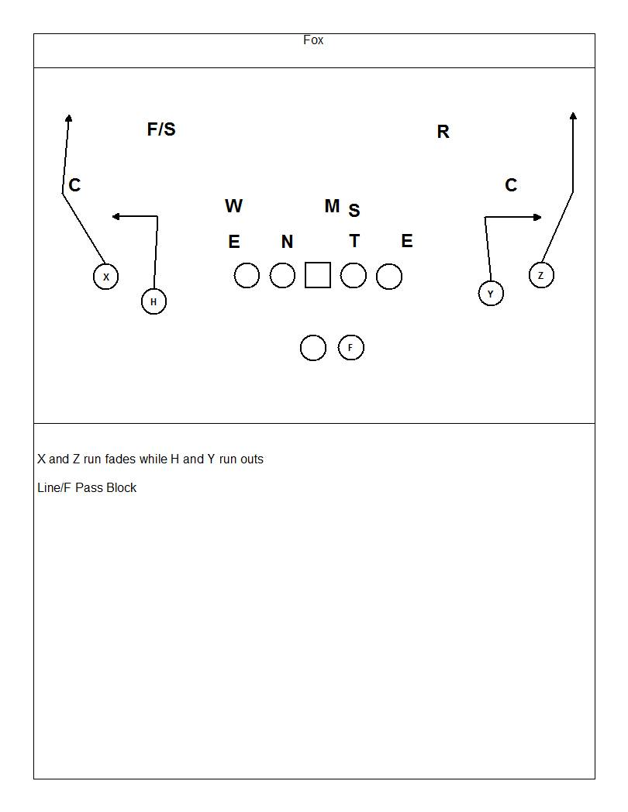

Slide 134
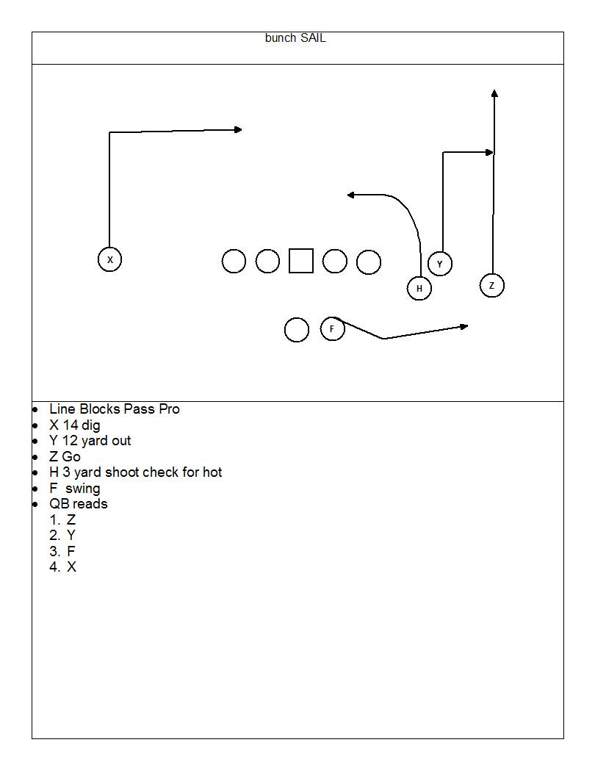

Slide 135
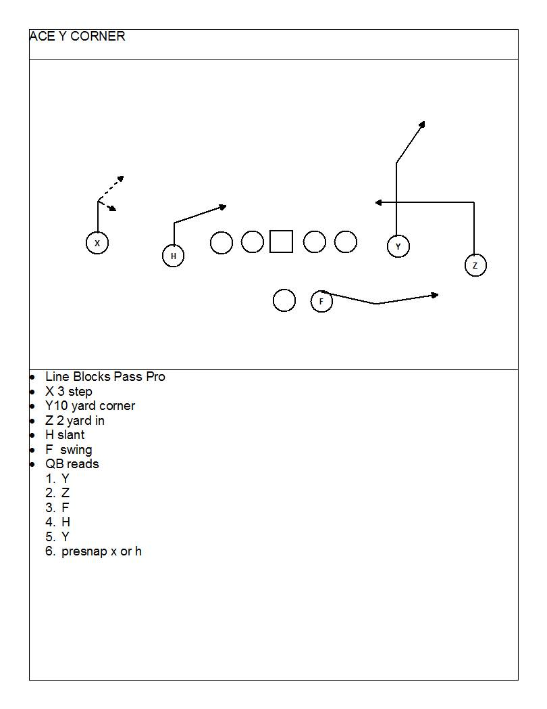
Bunch Corner

Slide 136
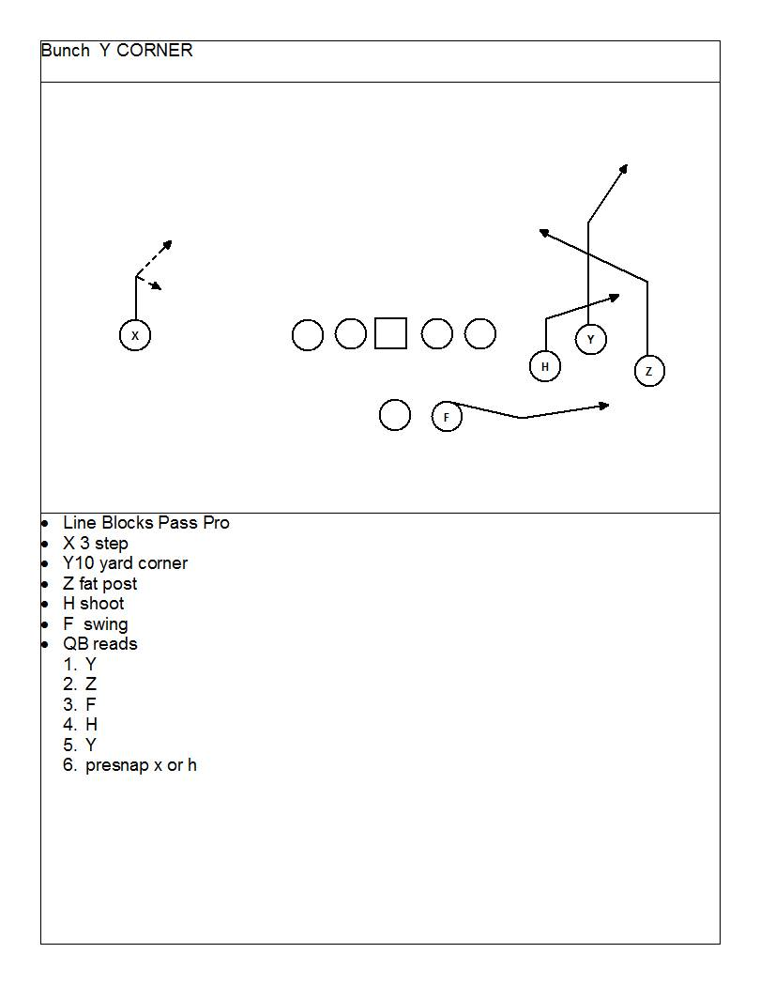

Slide 137
Specials
Jet Reverse
Shark Pass
QB Sneak
Pogo

Slide 138
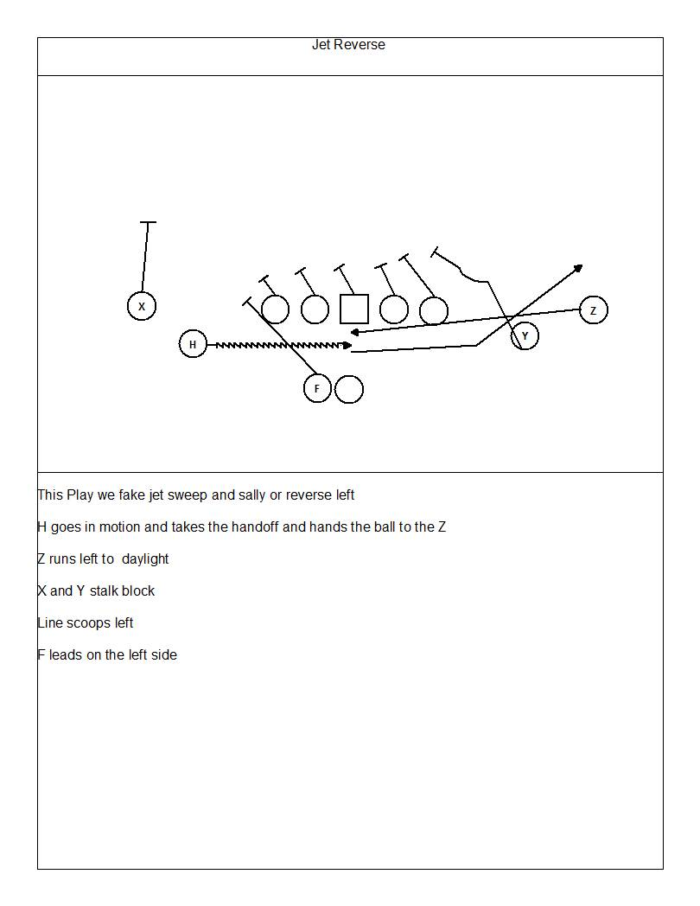

Slide 139
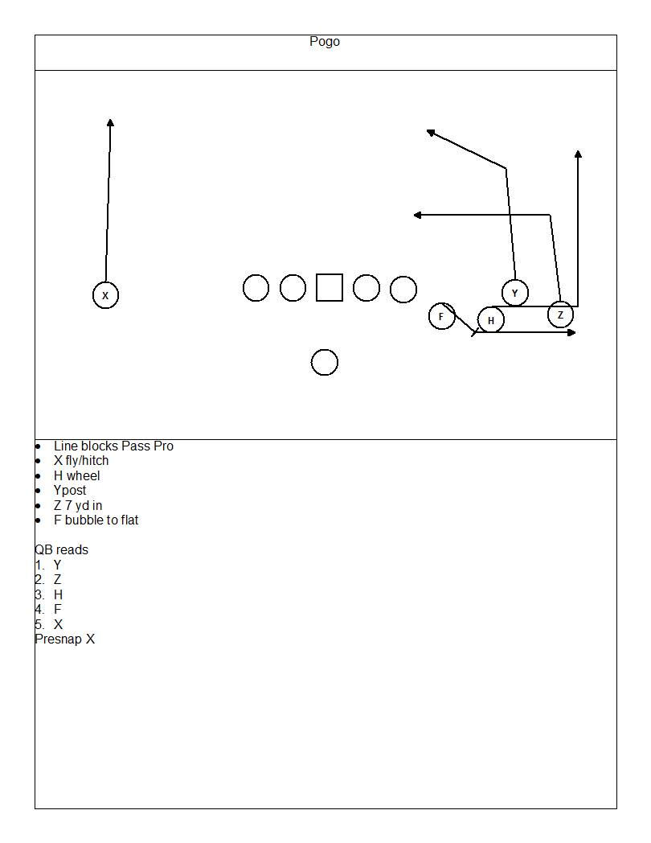

Slide 140
Play action Passes
Zone pass
Waggle
Jet pass

Slide 141
WAGGLE PASS DIAGRAM
S M
W
E T T E
QB must stay inside the pocket and inside the block of the pulling guard

Slide 142
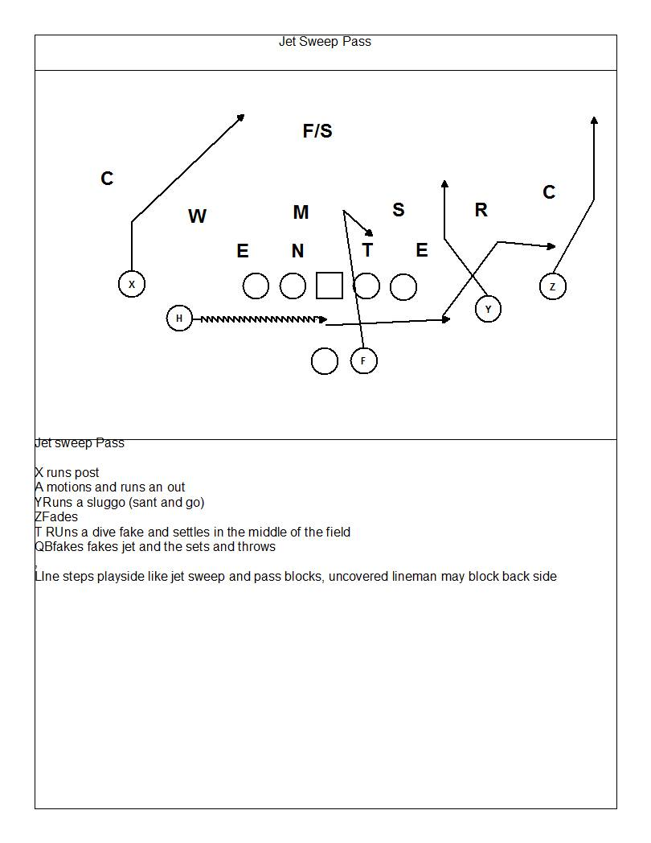

Slide 143
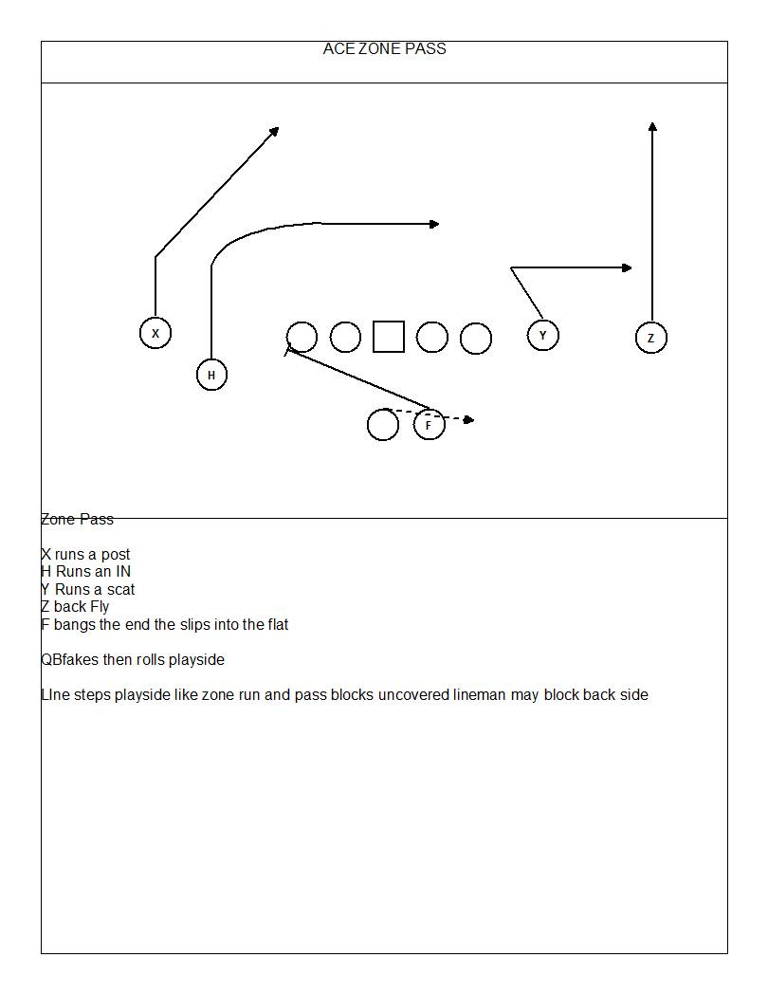

Slide 144
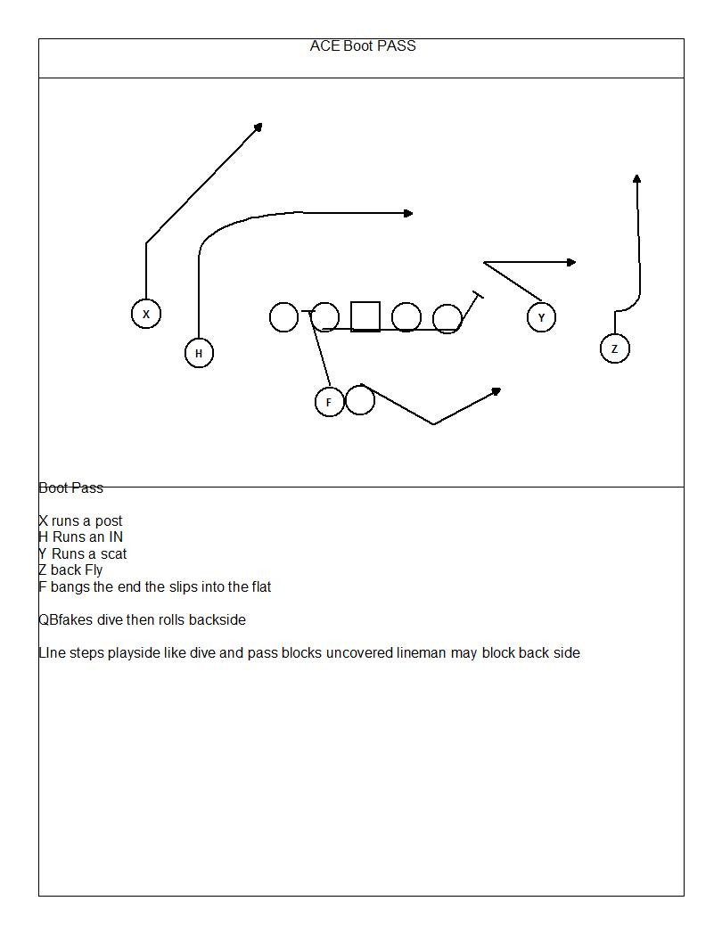

Slide 145
5 step passes
Sail
Mesh
Verticals
Smash
Y curl
Mesh Pow

Slide 146
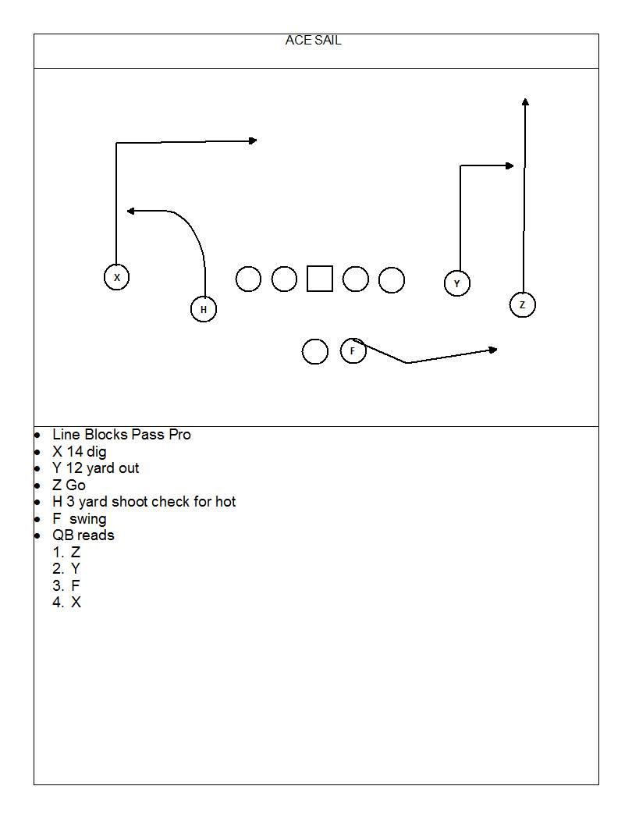
Bunch sail

Slide 147
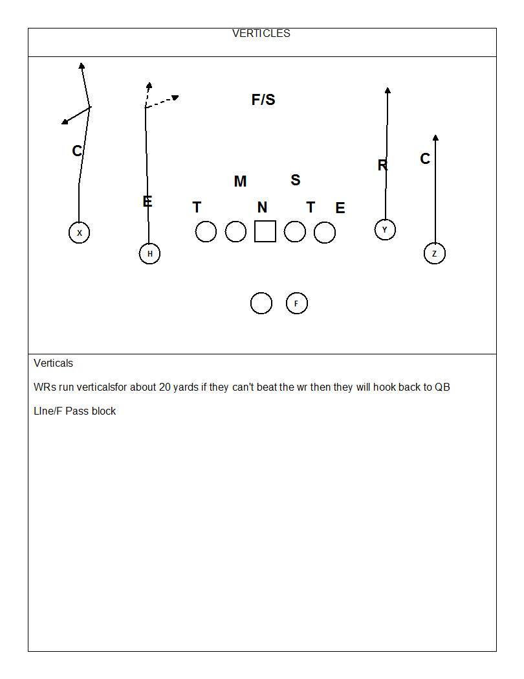

Slide 148
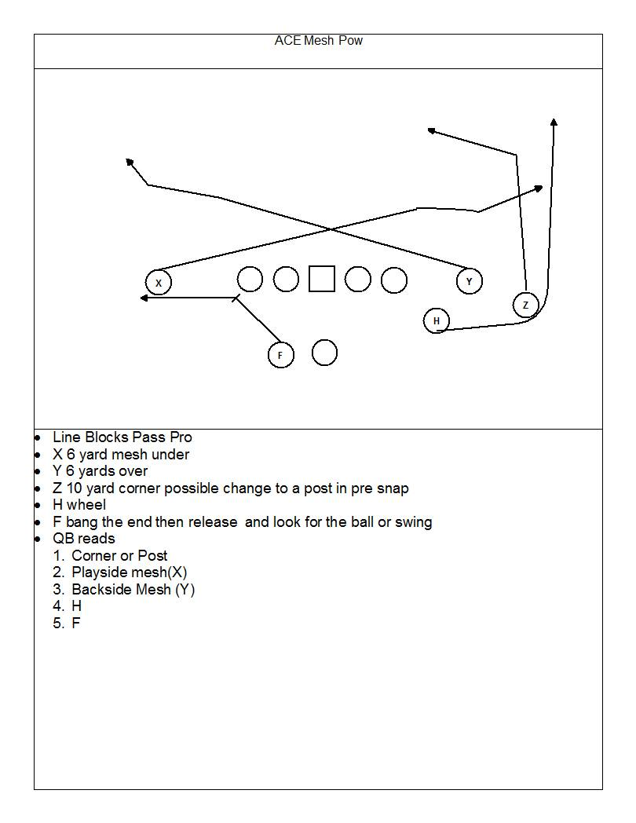

Slide 151
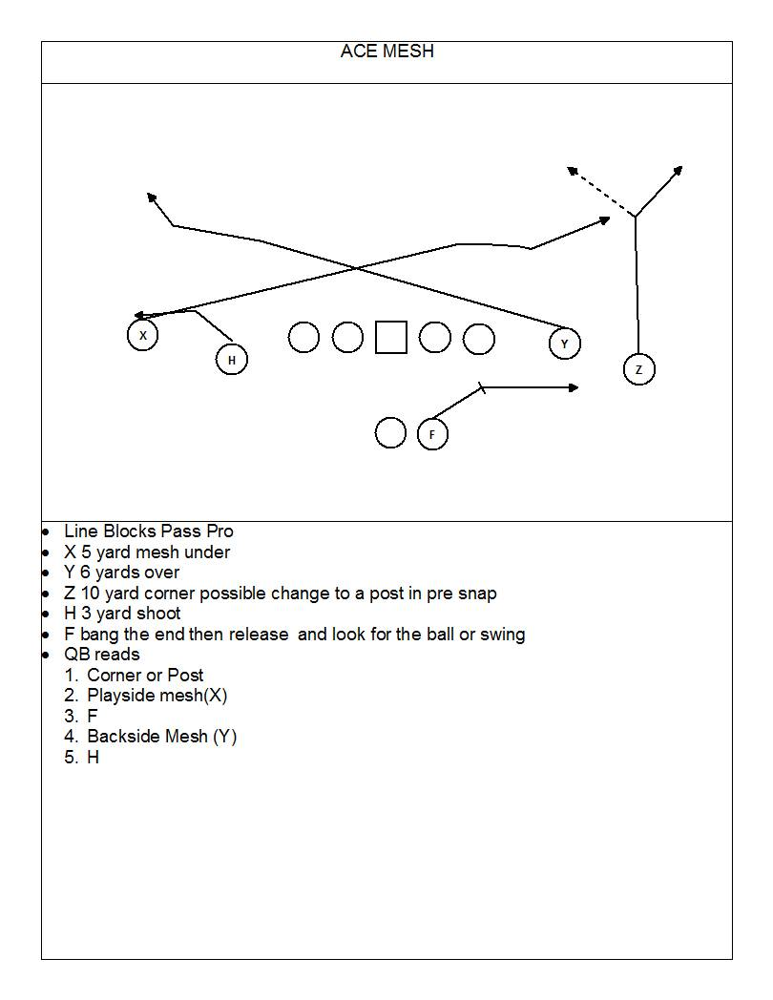

Slide 152
